Slide 1
The Concentration!
12 Artworks, Student Directed, Based on an idea of your choice! Working as an artist!

Slide 2
A concentration is defined as “ a body of work unified by an underlying central idea that has visual coherence.”
You will be required to write a short statement describing what your concentration is and how it evolved over time.
WHAT IS THE CENTRAL IDEA?
HOW DOES THE WORK DEMONSTRATE THE EXPLORATION OF THE IDEA?
Exam readers look for
“INVESTIGATION, GROWTH AND DISCOVERY”, “SUSTAINED INVESTIGATION”

Slide 3
Before you begin…
Research, plan, brainstorm, think, write, listen to music, watch your favorite movies, hang out with your friends…find inspiration everywhere!
Explain and describe your idea
Take photographs, collect images, sketches, etc
Figure out what you have ACCESS to that other people don’t.
Find artists/reference artists and works that have influenced you…write down the titles of specific works!
Once you’ve started….
Don’t get too broad- don’t say you are just “doing portraits.” Instead, state what it is about the portraits that interests or intrigues you, or what you hope to achieve through creating them
Keep growing…it’s OK to change…as long as you improve and expand on your original idea.

Slide 4
Concentrations are not:
Styles of art through history
Many ways to use acrylic paint
Angels
Emotions
Nature
Kitty Cats
Me and my boyfriend (or girlfriend) at rock concerts
My Dog (or hamster, or cat, or iguana, or bird)
Body Parts
State of the world as I see it
Winged horses and unicorns
Flowers
My Face on the body of celebrities, or famous portraits on my body
People who are unaware that they are the subject of my concentration
A Tropical Feel
A portfolio of paintings
Reverting to using a pen to draw rather than a pencil
Trees. Trees that show emotion. Happy little houses and mountains with happy little trees.
Well-lit sports equipment.
Anime, cartoons, caricatures, political cartoons, etc.

Slide 5
Concentrations are
Projects that you can find a number of solutions to, that are open ended, have room for infinite creative possibilities- Discovery and Growth! These can also fit your interests…try to think of some of your own. We don’t want to bore the Exam readers.
Freedom and Restraint
Doors and portals
Oppression of _____
Wrapped objects (what can this convey?)
An antique escapade (what objects could you find?)
Death with dignity
Adrenaline rush (interest in sports, extreme activities, outdoors)
Science- under a microscope, bacteria, abstractions
My world view (points of view, fisheye, fishbowl, key hole)
Things that fly or things that hang (lights, necklaces, mobiles)
Emerging from shadows
Order vs Chaos
Surviving ____________
Parallel Universe
My life as an ant…my life as a giant

Slide 6
Get researching: Artist Retrospectives
http://www.moma.org/interactives/exhibitions/2009/timburton/
http://www.moma.org/interactives/exhibitions/1996/johns/
http://www.metmuseum.org/special/Max_Ernst/images.asp
http://www.brooklynmuseum.org/exhibitions/andy_warhol/
http://lacma.viewbook.com/renoir_in_the_20th_century#1
Find out if your favorite artist had a retrospective- what themes do they use throughout their career? How do they continue to grow?

Slide 7
Contemporary Artists
Check the work of artists who are represented by galleries in NYC, Brooklyn and beyond. Look at EXHIBITIONS and SOLO SHOWS!
What themes do these artists work from?
What style of art history would you connect them to?
What do they say about their artwork?
College Art
Visit local colleges such as Adelphi University and CW Post
Look at work from college level students
Visit their BFA, MA, and MFA thesis receptions- what themes do they use?
What materials are they using?
How they conveying their ideas?

Slide 8








AP Studio Art Drawing Portfolio
Concentration Examples

Slide 9




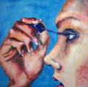


Mundane Tasks

Slide 10





2004

Slide 11
Briefly define the nature of your concentration project:
Through my concentration pieces, I attempted to display the seemingly mundane tasks of everyday life and make them seem more special and important. By utilizing a wide range of bright colors, the ordinary, daily activities people perform -- eating, sleeping, shaving -- become essentially more eye-catching, demanding a closer look.
Briefly describe the development of your concentration project and the sources of your ideas. You may refer to specific slides as examples.
For one reason or another, I find myself surveying the human figure, tracing what I see with a mental finger -- outlining a shoe or a hand. Also, I chose to focus on people in their daily routines in order to capture an element which is essentially private and because I feel a close contact with those that I paint. Artists such as Johannes Vermeer and Edward Hopper, who gave great importance to domestic and private activities, served as a source for these ideas. I wanted to use a wide range of colors to give each painting personality, a flair, a jolt... And, colors are simply more fun.

Slide 12







Mechanical Objects

Slide 13





Rationale for Score: In this portfolio, the student presents a thorough investigation of the structure of mechanical objects through selective drawing. This student’s informed understanding of contrast relationships is stylistically confident and consistent. Form is rendered by the student’s close attention to structure and detail and is presented in varying perspectives. Color is used for emphasis and facilitates visual movement. The student’s highly developed drawing skills are technically consistent throughout this body of work.
6
2007

Slide 14
What is the central idea of your concentration?
My concentration is on mechanical objects. The subject matter in my pieces ranges from cars to hack-saws, to speakers. I chose this focus because I wanted to take a brake [sic] from the everyday portraits and do something I find interesting. The development of my pieces was a long process, because I first had to find my objects and then execute them in a very creative and distinguished manner. Most of the subject matter I chose is either my belongings or objects I have seen somewhere else.
How does the work in your concentration demonstrate the exploration of your idea? You may refer to specific images as examples.
All of my concentrations are done in pencil or acrylic paint. From the beginning of my pieces, I used pencil because I was more drawing orientated [sic], then as I got more practice with paint; my pieces progressed into realistic vivid works. In the end I am proud of my pieces and happy with the way they turned out.

Slide 15
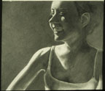
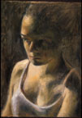
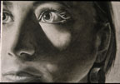

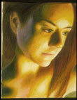

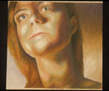
Abstraction of the Human Figure

Slide 16



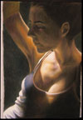

Rationale for Score: An evocative theme, inspired by observation and photo references, is presented in these figure drawings. Additionally, a sense of real and uncluttered space is rendered through expressive mark-making, value and color contrast, and sophisticated lighting. This student uses chiaroscuro and tenebrism that go beyond mere special effects. Of further note is the student’s informed use of point of view in a variety of perspectives—birds-eye, eye level, and worms-eye—and use of the full pictorial space. The quality of craftsmanship is excellent.
6
2007

Slide 17
What is the central idea of your concentration project:
The central idea for my concentration was to create an abstraction of the human figure through movement, color, and different light values. With these strategies I was able to form abstract shapes which detached the figure from its traditional image.
How does the work in your concentration demonstrate the exploration of your idea? You may refer to specific slides as examples. As my concentration progressed I found to gain the movement and abstraction I was searching for in the human figure I had to have a strong concrete light source. Images 1 through 3 best show the affects of a strong light source and how movement can be captured within the highlights, midtones, and shadows. Furthermore, with this light I was able to begin the beautiful abstract tone to pieces. I noticed as the light source became more intense I was losing the midtones. I admired the images without them, and I noticed the abstract shapes that were being formed. As my concentration progressed I had to search for ways to create shapes in order to abstract the human figure. I then began to direct the figure into a more contorted form (images 5 through 12). As can be noticed, muscles within the neck and upper body became more prominent and formed obscure shapes. This took it to a more abstract level, each of my pieces progressively looking less like the human figure. I also began to incorporate abstract colors, which helped the body morph into abstraction (images 5 through 7 and 11 through 12). With my concentration I want my viewers to discern the human figure as being beautiful through its progression to an abstract shape.

Slide 18
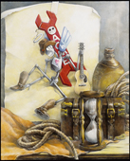
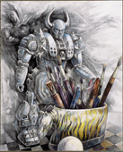
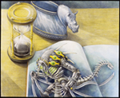
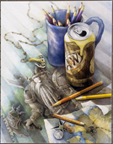
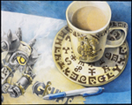
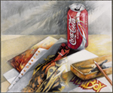
My Space

Slide 19
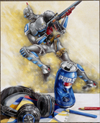
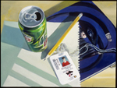
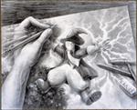
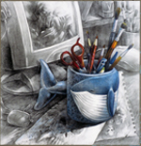
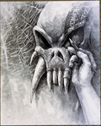
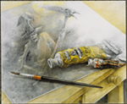
Rationale for Score: These works make a highly imaginative connection between the idea of the concentration and the work presented. The inventiveness and exuberance reflected in the works engage viewers, inviting them to identify with the student in images 9 and 11. The works demonstrate highly effective integration of concepts and drawing skills. Mastery of techniques is outstanding, and developmental thinking goes well beyond technical concerns. The work is of excellent quality and gives voice to the student’s unique vision. The theme is evocative.
6
2008

Slide 20
What is the central idea of your concentration?
The theme was “my space”, which incorporates the factual, tangible, and conceptual things that I have seen and combin[ed] with image[s] of my own creative works.
How does the work in your concentration demonstrate the exploration of your idea? You may refer to specific images as examples.
Most of [the] images are a picture of a hand drawn characters that I have developed or is an alteration of already existing characters. There are also realistic pictures of actual objects like hands, art supplies, and cans. Every characters besides Spawn in image 2, Hellboy in image 5, and the cyclopian figure in image 7 are all compl[e]tely original. The borrowed characters have been redrawn with alteration.

Slide 21

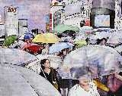
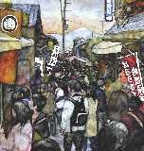
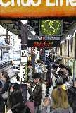

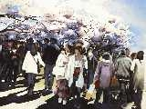
Crowds of People

Slide 22
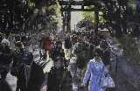
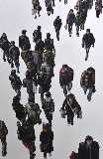
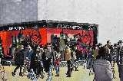
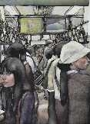

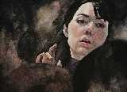
Rationale for Score: The portfolio presents a compelling visual study of an everyday situation, with the artist placing herself somewhere within the image. The work reflects a mature exploration of subject matter and watercolor technique. Versatility of the color palette is notable, as seen in images 1 and 11.Atmospheric perspective effects are emphasized in image 6, while the drama of light and shade is most evident in images 7, 10, and 12.Deliberate spatial tension is created through the variety of approaches to the subject matter, including the overlap of form in image 2 and the scale of figures in images 3, 4, and 8.The concentration is explored in a myriad of ways and is inventive and original.
6
2009

Slide 23
What is the central idea of your concentration?
The subject of my concentration is crowds of people. I wanted to explore the ways that being in a crowd make me feel. Because of this I did a series of watercolor paintings, and painted myself into each one. I also tried to give each piece an overriding emotion.
How does the work in your concentration demonstrate the exploration of your idea? You may refer to specific images as examples.
In my work I wanted to challenge myself to convey an abstract emotion in a realistic piece of art. I experimented with different styles and techniques of painting to create a distinct mood in each picture. For example, in my sixth piece I used high contrast and bright colors, and a lot of white, which gave a cheerful and upbeat feel to the painting. In my eleventh painting I used subtle muted colors and soft lines to encourage a quiet and detached atmosphere. I also included a depiction of myself in each piece. In most of my pictures I made myself very small, but as my work evolved and I became more confident in my ability I ended up painting myself bigger, so that my later pieces are more of self portraits.

Slide 24

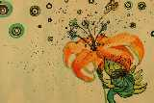
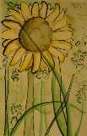
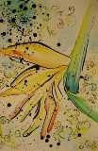
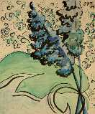
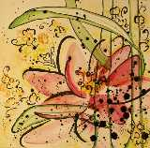
Abstract Nature

Slide 25
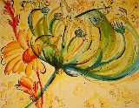
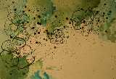




Rationale for Score: The connection between the concentration topic and the work presented is evident. There is moderate decision making and emerging growth seen in images 9 and 11, although the detail images 10 and 12 seem unnecessary. Though uneven, the work demonstrates emerging technical skills. The line variation seen throughout the work adds playfulness to the student's voice. Overall the work exhibits an emerging level of accomplishment.
3
2010

Slide 26
What is the central idea of your concentration?
My concentration is abstracted nature studies. I derived inspiration from artist Bobbi Meier, and a visit I made to Longwood Gardens, Pennsylvania. I achieved this through exploration of techniques in watercolor and ink.
How does the work in your concentration demonstrate the exploration of your idea? You may refer to specific images as examples. As my portfolio begins, I was focused on color and unity. Through the portfolio I took greater risks and explored the media further by experimenting [with] new techniques. As the portfolio progresses, I began focusing on the element of texture, and the principles of repetition and unity. Many pieces have the same background detail, as demonstrated in image 7. This detail gives the piece a whimsical, fantasy feel while providing unity through the portfolio. The use of sumi ink in both the foreground, and the background as in image 4, also creates unity through the portfolio. Texture was created through various techniques with the watercolor, such as salt, alcohol and imprinting, which is very dominant in images 9 and 11.

Slide 27
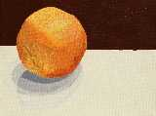
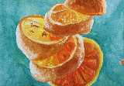
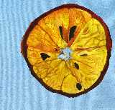
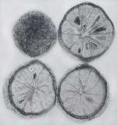
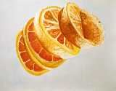
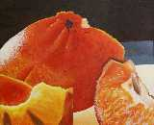
The Orange

Slide 28
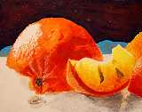

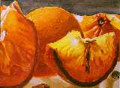
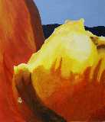
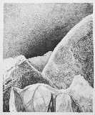
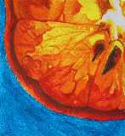
Rationale for Score: The concentration topic and the work presented are closely associated. Although the work demonstrates adequate technical competence with a range of drawing media, growth and experimentation are somewhat limited. The work exhibits some clear decision making with regard to design solutions but generally lacks a sensitivity to space and figure/ground relationships, as in images 3, 4, 5 and 12.Generally the work exhibits uneven levels of accomplishment but overall is of good quality.
4
2010

Slide 29
What is the central idea of your concentration?
Oranges can be found within many classic still-life paintings as an accent of color. Artists such as Cezanne rendered the fruit with minimal brush strokes and thus simplified the many details of an orange. My concentration focused on the single subject of an orange, cut and arranged to make an interesting composition with a specific focus on the textures. By slicing and magnifying the orange, I created realistic portraits of the fruit that eventually progressed to more abstract renderings.
How does the work in your concentration demonstrate the exploration of your idea? You may refer to specific images as examples. Traditionally, the great multiplicity of the common orange's image is simplified by still life artists who use the orange as a spherical jolt of color. My concentration focused on the ignored details of an orange. Through my concentration, I learned how to portray the orange in a way that focused on the many textures instead of the general appeal of the brightness of the subject. Some of my pieces were done in watercolor which best illustrated the translucent nature of a sliced orange (see images 2, 5 and 9). In my oil pastel and acrylic pieces, I built up the texture through such techniques as impasto to show the uneven textures of the peel (see both 7 and 1). Each medium stressed different qualities found in the subject of an orange. As my pieces progressed, I became less focused on the forms of the spherical orange and more focused on the abstract shapes and textures created when an orange is dissected.

Slide 30
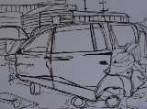
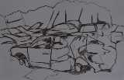
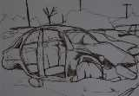
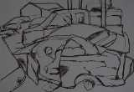



Wrecking Yard

Slide 31





Rationale for Score: The student presents a strong body of work with an engaging visual theme. The work is technically strong; markers and colored pencils are used well to express the ideas. There is growth and transformation from early flat line drawings like images 1 and 4.In images 5 and 6, line variety and overlapping help create three-dimensional form and space. Improvement in both composition and range of values is evident from images 7-12.The work presents an original vision and overall is of strong quality.
5
2010

Slide 32
What is the central idea of your concentration? Since I was a little kid I played at my godfather's wrecking yard. I was fascinated with exploring the wrecks. I began to think about the wrecks and how the wrecks happened. When someone crashes a car it is violent and noisy. Dreams are demolished. People are injured and sometimes killed. My drawings make me think of broken dreams.
How does the work in your concentration demonstrate the exploration of your idea? You may refer to specific images as examples. At first I explored my ideas using a brown marker on white paper [images 1-6]. Then I began to get interested in the range of values and reflections on the wrecks. I used white colored pencil, an Ebony [pencil] on toned paper [image 7-12]. My brother's dream car was a silver 2001 Lincoln Town Car [image 7]. It is now a wreck. [I] feel really close to this work since [I] helped rebuild his car before it was wrecked.

Slide 33






Animalocalypse

Slide 34






Rationale for Score: Integration of the concentration topic and the presented work is succinct and unmistakable. Art-historical references and the narrative structure of the work exhibit innovation, investigation and thoughtful, sophisticated decision making. The work is technically excellent, and the watercolor medium is effectively used to express engaging and whimsical ideas. The appropriation of themes or photographic sources clearly provides a visual reference that is uniquely transformed and placed in service of a larger, personal vision. Overall the work is outstanding and sustains a high level of conceptual and technical accomplishment.
6
2010

Slide 35
What is the central idea of your concentration?
This concentration "Animalocalypse" is a narrative series that resembles an alternate universe where the roles of animals and humans are switched. Several are based from famous paintings (the first, fifth and last images), but the majority of the watercolors are done from my imagination. As they progress from the first to the last, the message grows more suggestive to the viewer. Some paintings have a more light hearted mood, and all provoke a story.
How does the work in your concentration demonstrate the exploration of your idea? You may refer to specific images as examples. There were many ideas I originally had that I never ended up making, because the other ideas were either stronger, or easier for the viewer to be able to understand. I really enjoyed this concentration, because there were many things I could do that could represent the idea of animals and people switching places. Before I began working on them, I listed the best ideas, and put them in a specific order so I would be able to easily transition from one painting to the next. Some of my work, like image 11, titled "Fair Game," have [sic] a much darker context than some of its earlier cousins. I did this on purpose; once the viewer was pulled in, they would notice that the revolution of the animals became more serious as the sequence continued.

Slide 36

Score 6
2011
Small colored pencil works
First one is tempera paint
Largest colored pencil is 11x14

Slide 37


Slide 38

Score 5
2011

Slide 39


Slide 40


Slide 41


Score 4
2011

Slide 42


Slide 43


Slide 44


Slide 45


Score 3
2011

