Slide 1
Concentration Ideas
Contemporary mythology

Slide 2
1. Mythological characters in contemporary settings copying recognizable scenes from famous paintings, showing that the same morals and such apply today, I guess
Medium: pencil, charcoal, black and white photography
Principle of art: contrast, emphasis, value, space
Artists: The Fashionisto, John William Waterhouse, Rembrandt

Slide 3
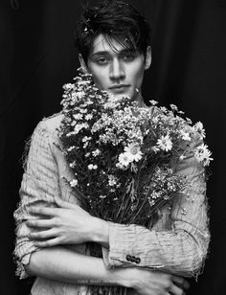
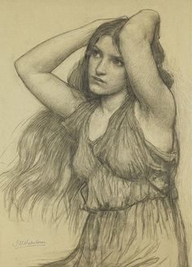
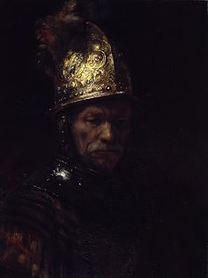

Slide 4
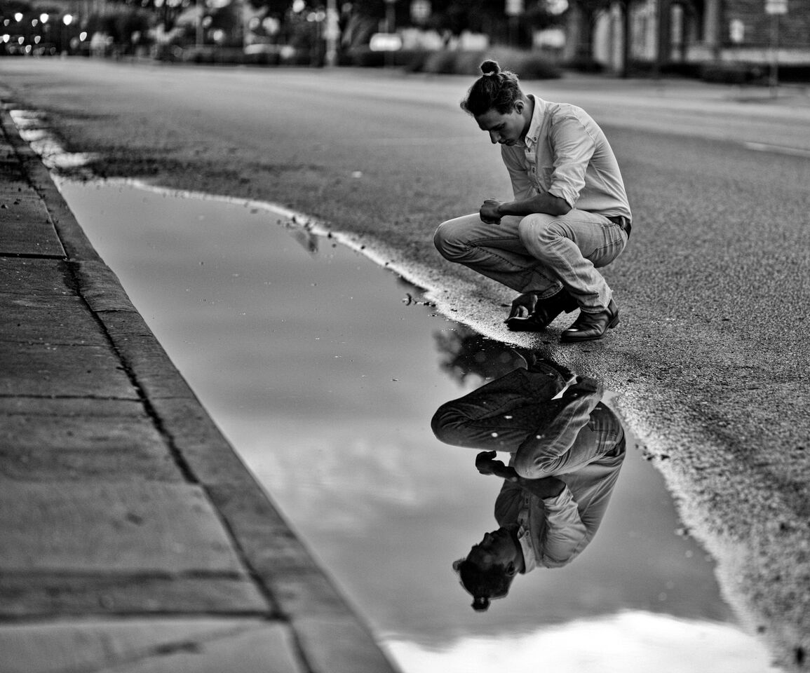
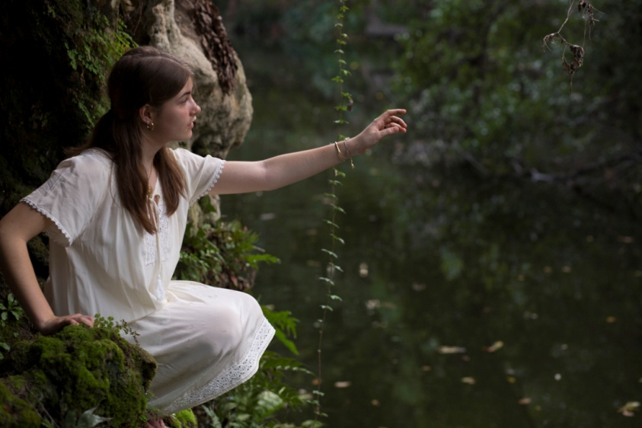

Slide 5
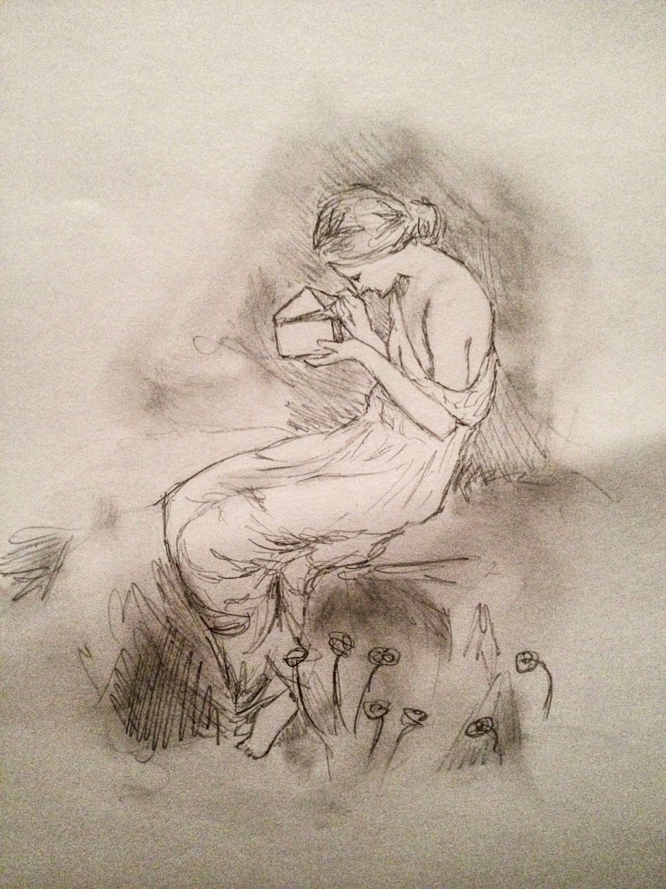
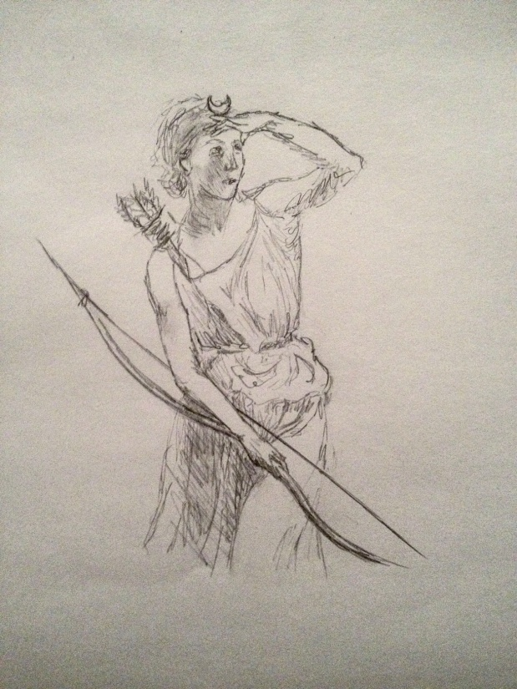

Slide 6
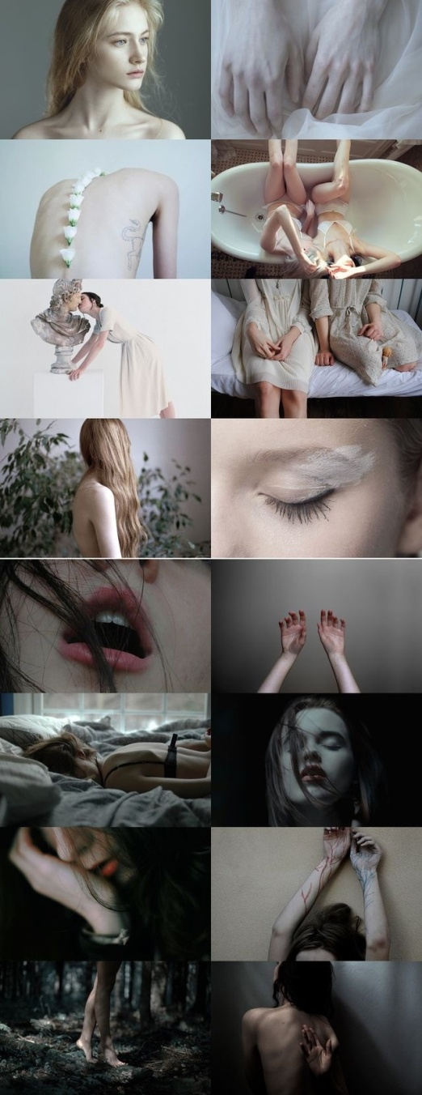
2. Either twelve scenes from one myth, also possibly adding words, or twelve angles
Medium: colored pencil, photography, water color
Principles of art: color, shape and form, line, balance, repetition
Artist: John Singer Sargent, Waterhouse

Slide 7
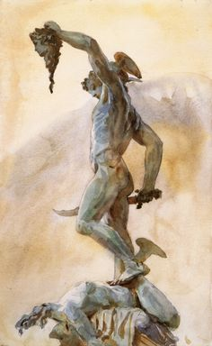
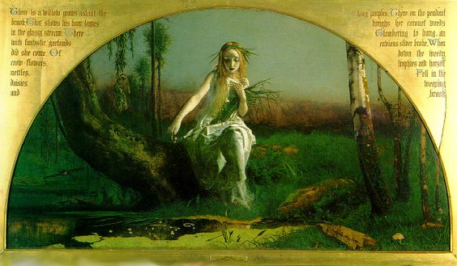
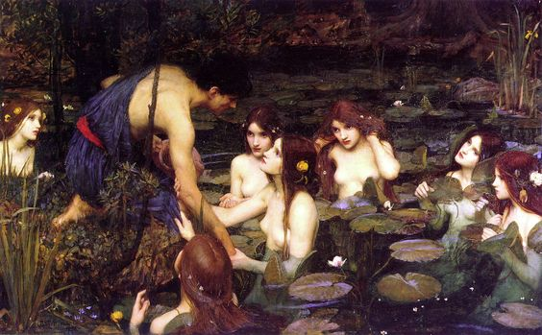

Slide 8
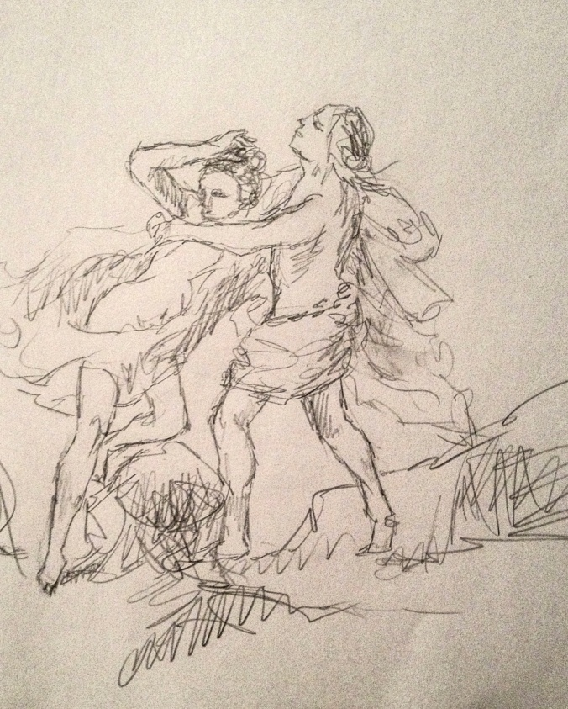
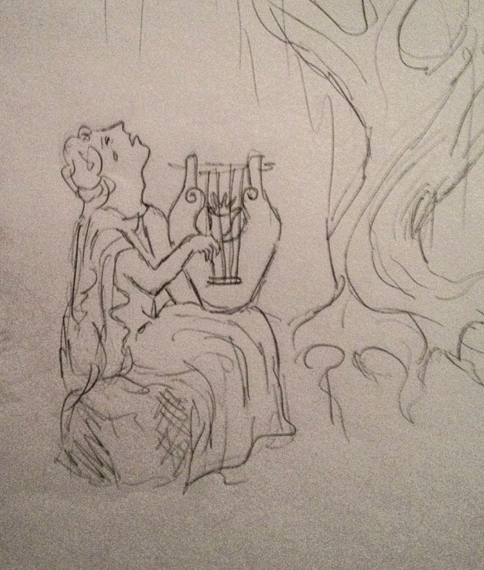
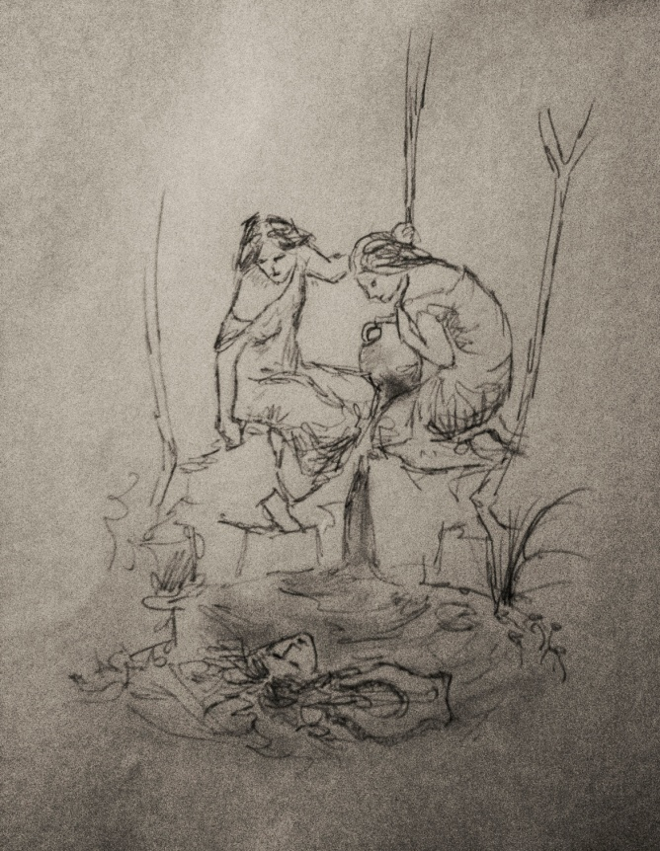
Orpheus

Slide 9
3. Progression from light to dark/order to chaos/color to back and white/defined to unfinished
Medium: photography, pencil, charcoal, paint?
Principles of art: value, emphasis, texture, movement
Artist: Bouguereau, Eugene Delacroix, Francisco Goya, Rembrandt
Instead of sketches: these are the ways I would pose these artists

Slide 10
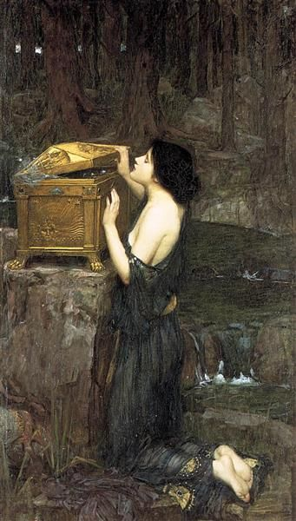
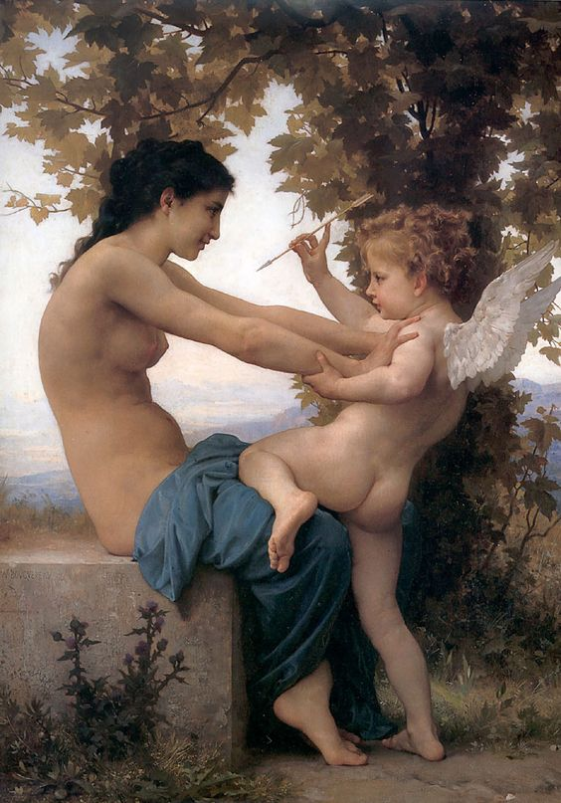
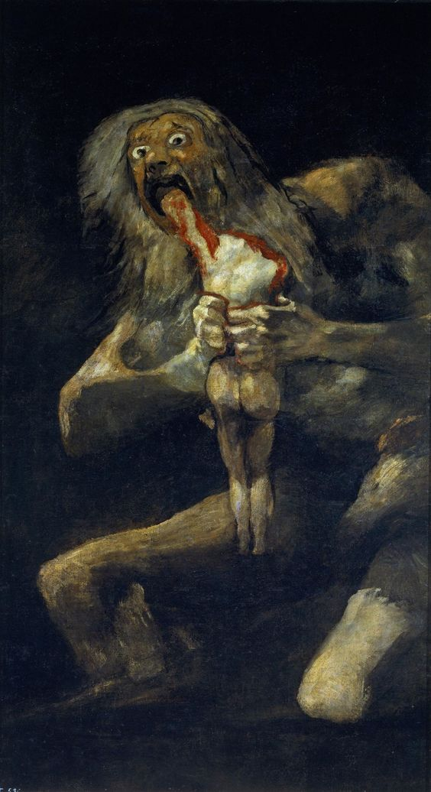
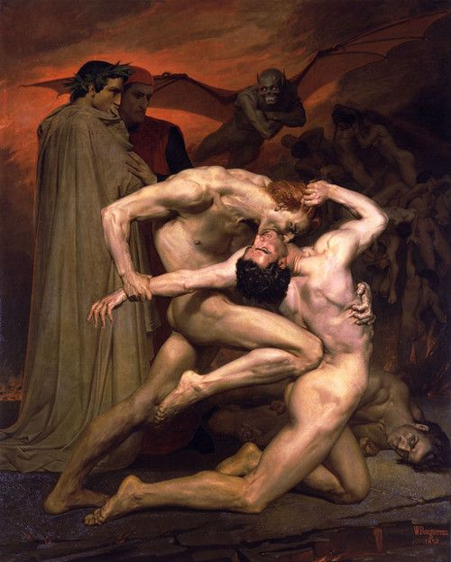
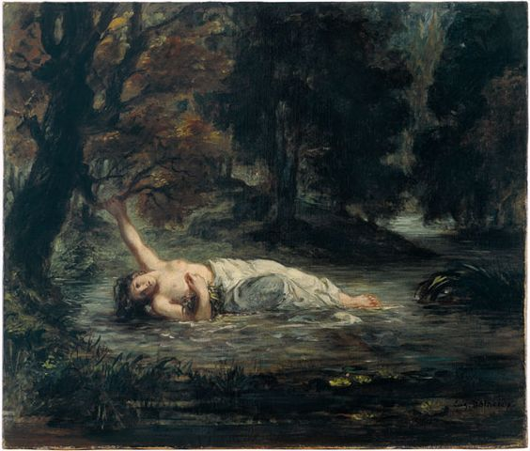
Ideas of how I would pose my figures for my paintings.
Notes:
Instead

