Slide 1
Concentration Ideas
AP Art
Lauren Ferguson

Slide 2
♡ Idea 1: My idea ♡
I wish to draw light to the purgatorial state of being an adolescent girl, existing between girlhood and adulthood. Using the pre-Raphaelite era as a sort of muse, my theme will develop through portraying girls in nature with the gradual inclination of age.
♡ My medium(s) ♡
Color pencil, photography and watercolor
♡ My principle(s) of art ♡
Form and line
♡ My inspirational artist(s) ♡
Waterhouse
Sir Frank Dicksee
Edgar Maxence

Slide 3
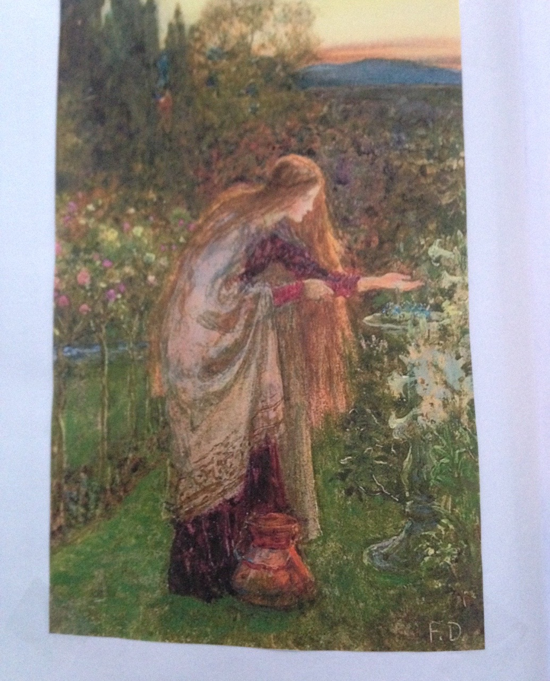
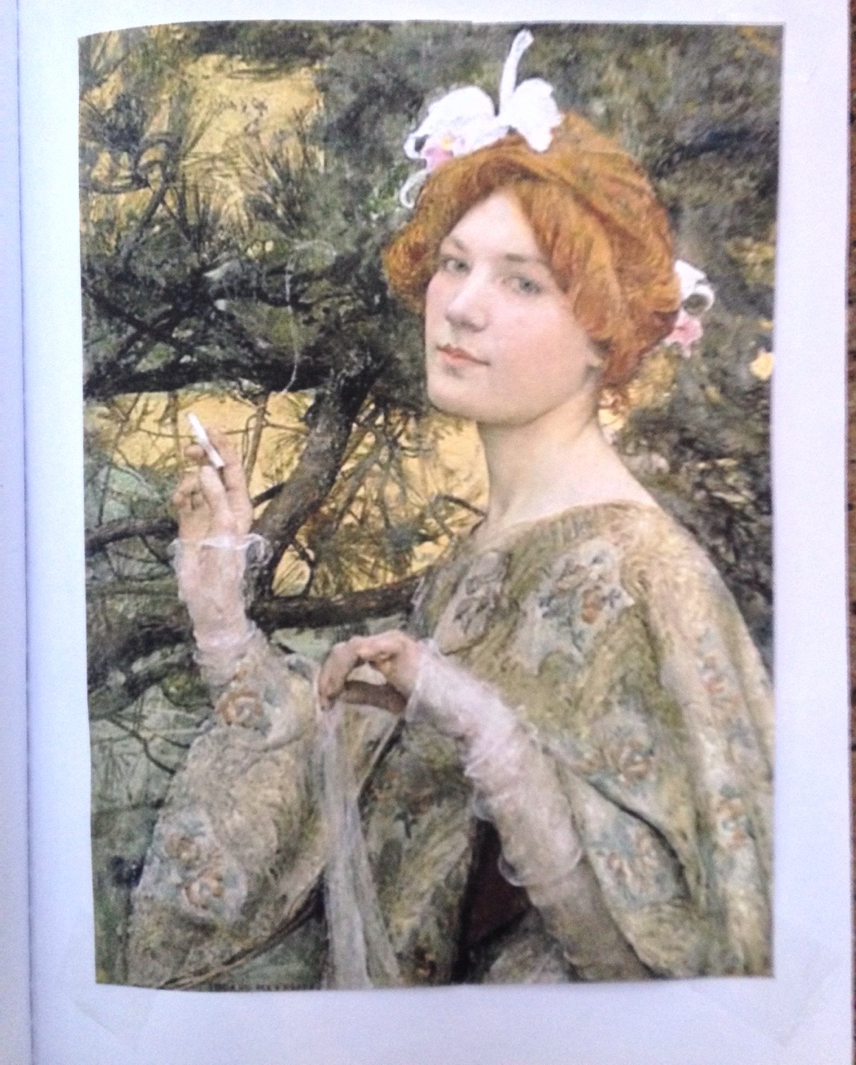
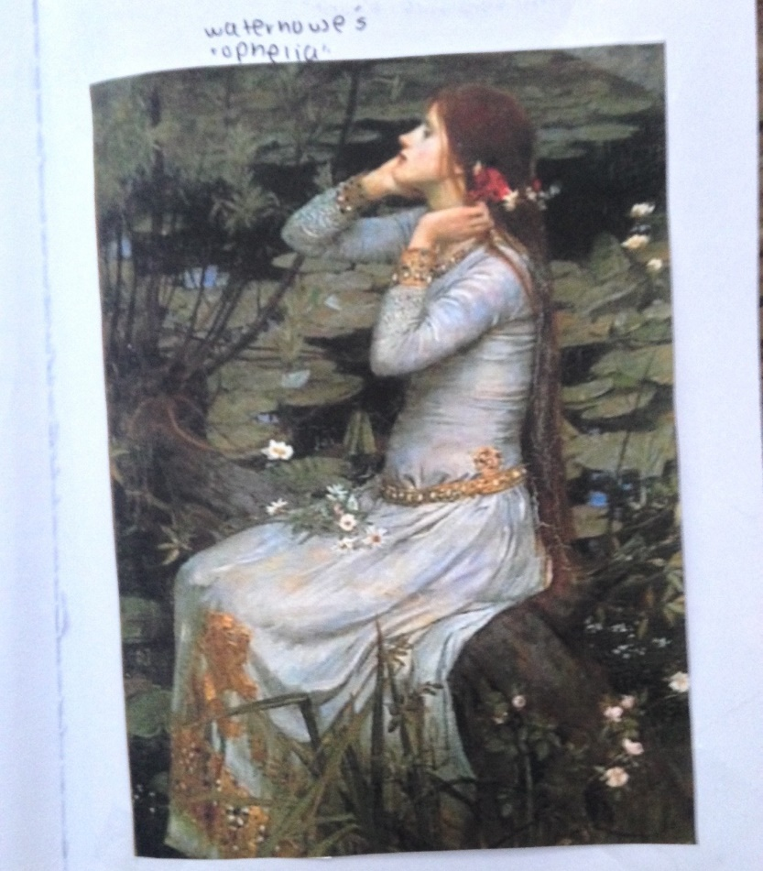
Sir Frank Dickson’s
“La Femme a L’orchard”
Edgar Maxence’s
“The Sensitive Plant”
Waterhouse’s
“Ophelia”

Slide 4
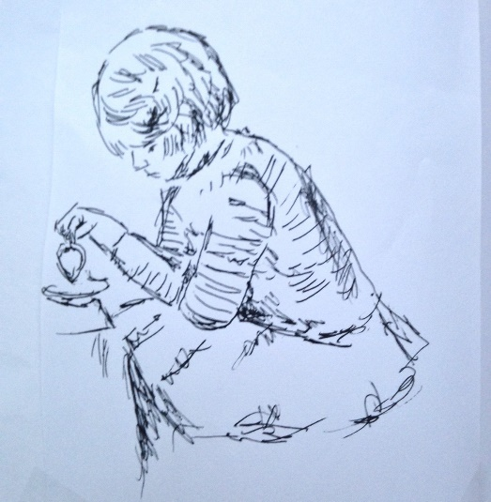
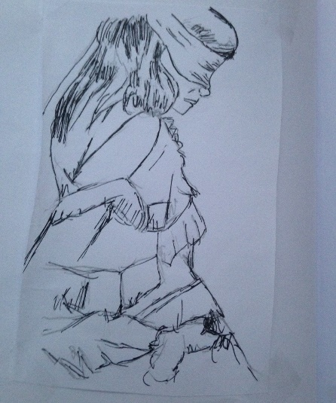
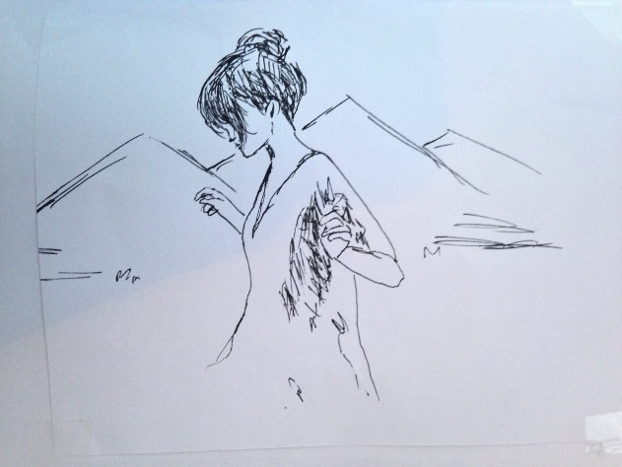
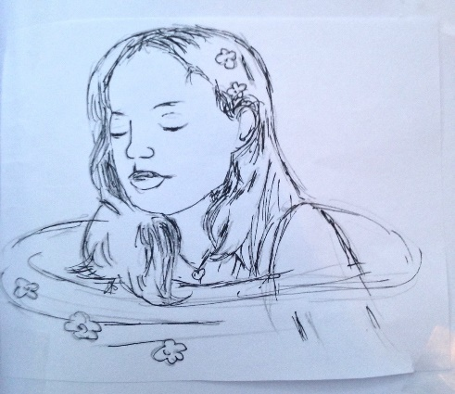
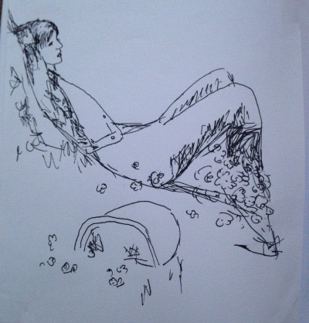
♡ Sketch 1 ♡ ♡ Sketch 2 ♡ ♡ Sketch 3 ♡ ♡ Sketch4 ♡ ♡ Sketch 5 ♡

Slide 5
♡ Idea 2: My idea ♡
Using the pre-Raphaelite era as a sort of muse, my theme will display a deconstruction of the “Ophelia architype” found in mythology, fairytales and Shakespearian tragedies.
♡ My medium(s) ♡
Photography, watercolor and oils
♡ My principle(s) of art ♡
Contrast
♡ My inspirational artist(s) ♡
Waterhouse
Gustav Klimt
John Everett Millais

Slide 6
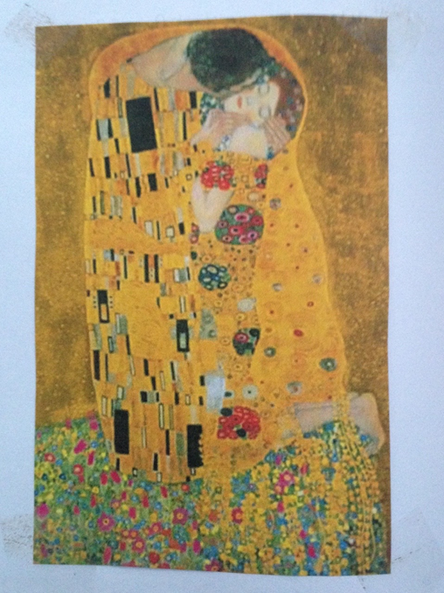
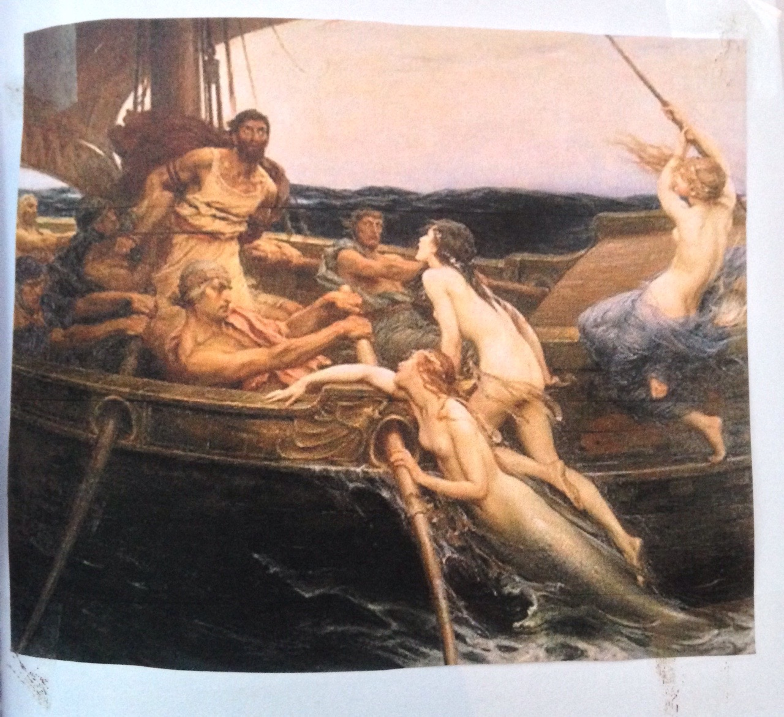
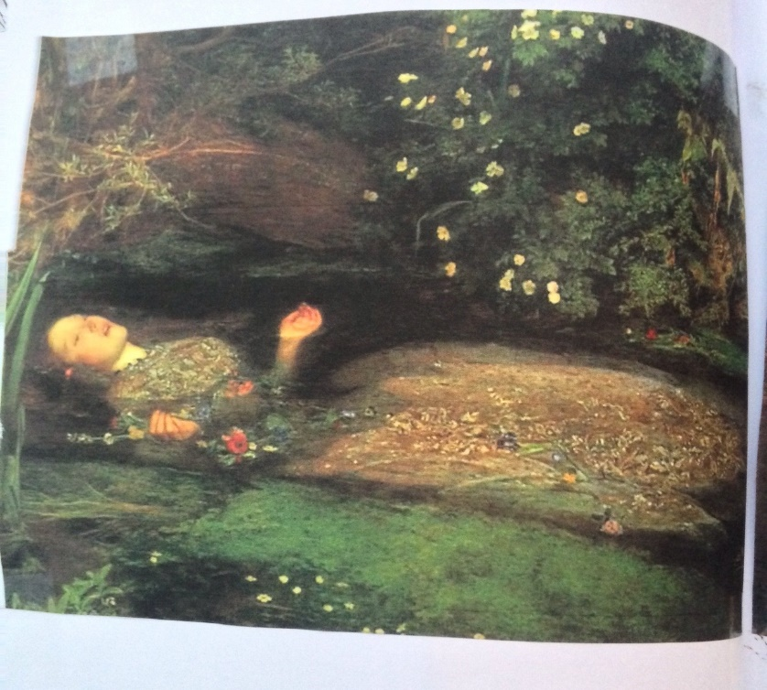
Waterhouse’s
“Odysseus and the Sirens”
Gustav Klimt’s “The Kiss”
John Millais’
“Ophelia”

Slide 7
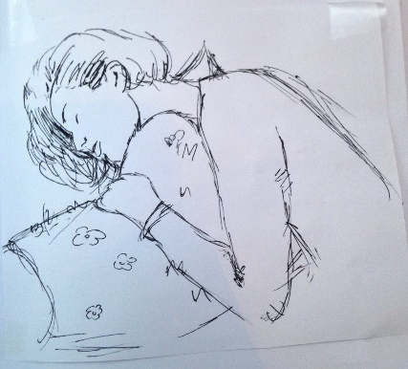
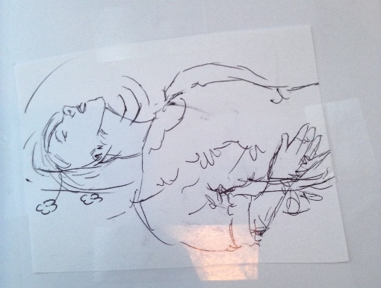
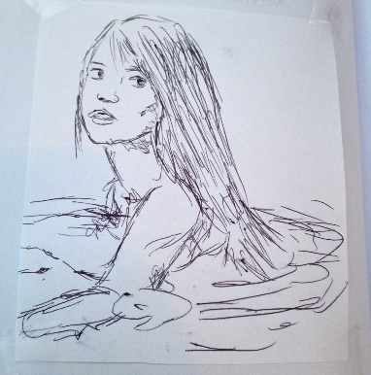
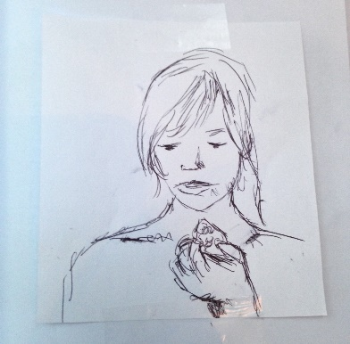
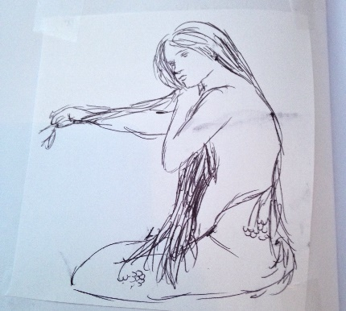
♡ Sketch 1 ♡ ♡ Sketch 2 ♡ ♡ Sketch 3 ♡ ♡ Sketch4 ♡ ♡ Sketch 5 ♡

Slide 8
Idea 3: My idea ♡
Using the pre-Raphaelite era as a sort of muse, my theme will investigate girlhood that in which heavily coincides with themes of nostalgia and emptiness.
♡ My medium(s) ♡
photography and color pencil
♡ My principle(s) of art ♡
contrast
♡ My inspirational artist(s) ♡
Ali Cavanaugh
Ariko Inaoka
Fredrick Morgan

Slide 9
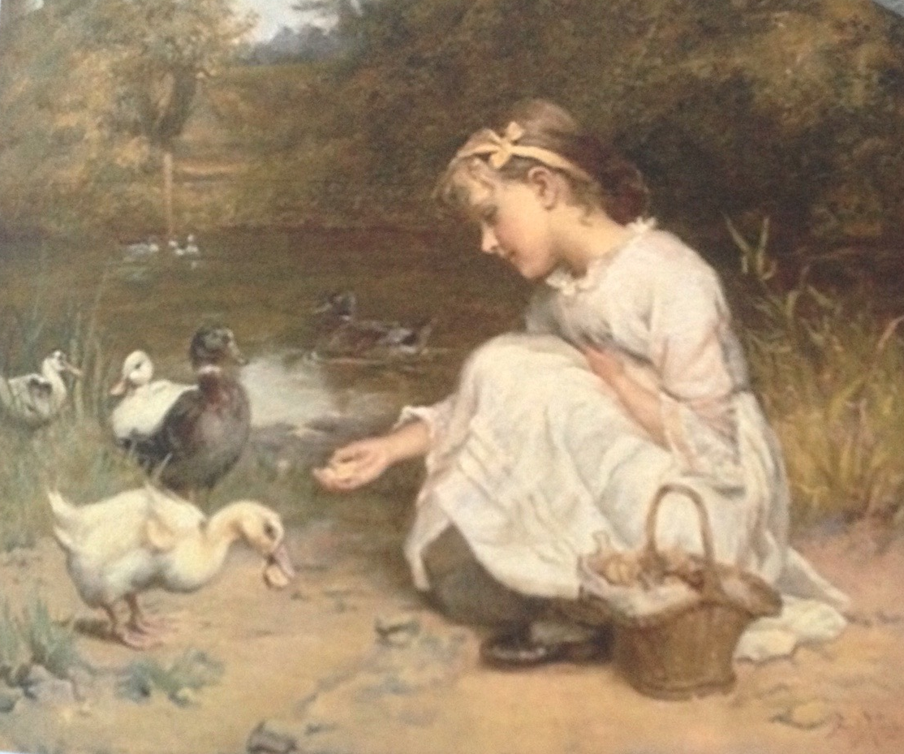
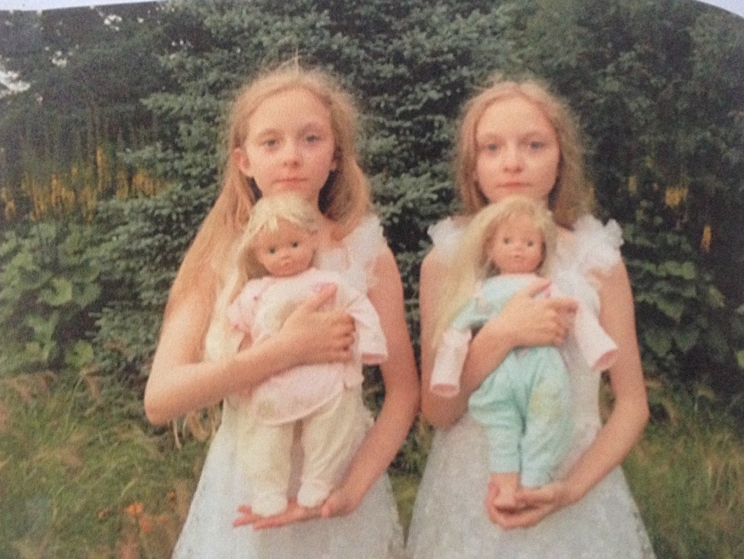
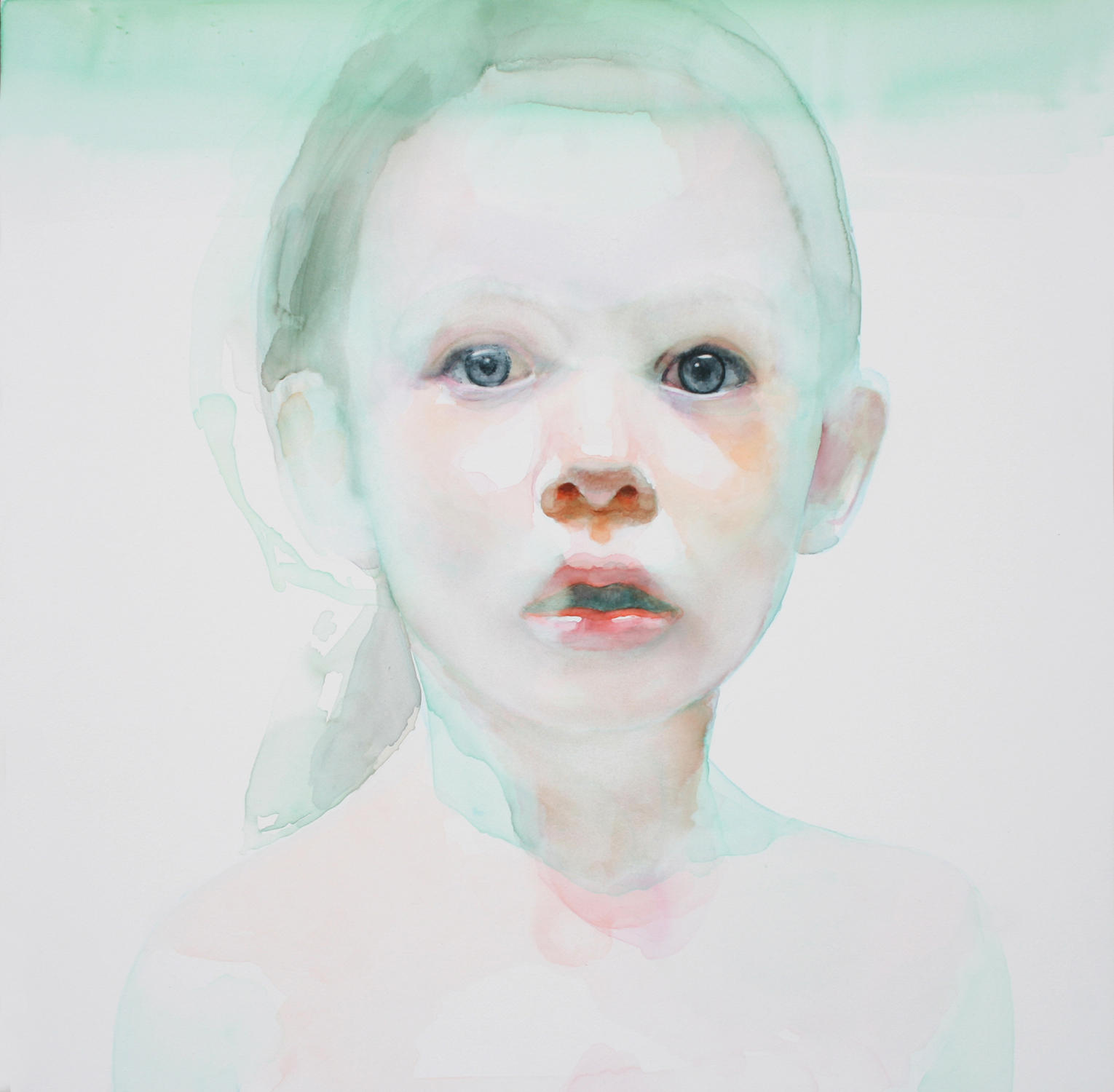
Frederick Morgan
Ariko Inanka
Ali Cavanaugh

Slide 10
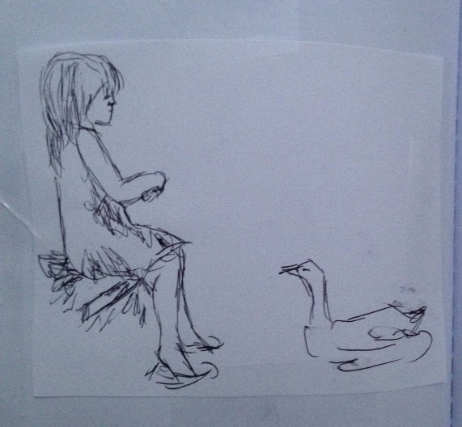
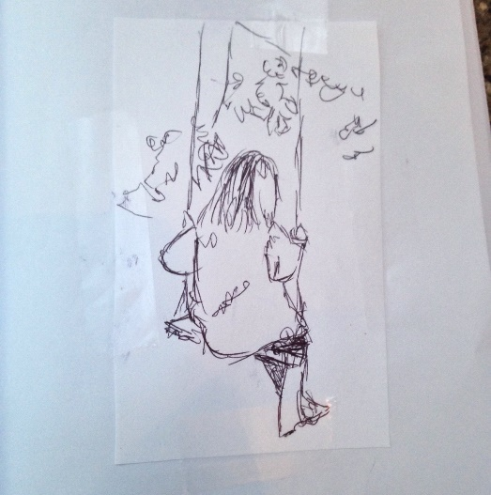
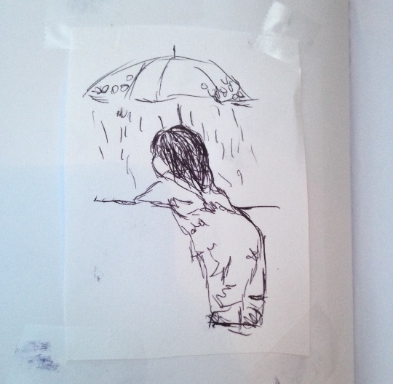
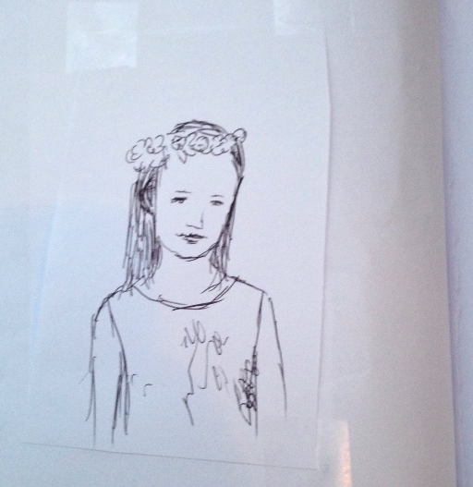
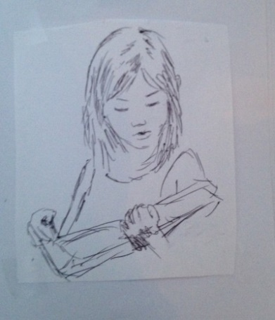
♡ Sketch 1 ♡ ♡ Sketch 2 ♡ ♡ Sketch 3 ♡ ♡ Sketch 4 ♡ ♡ Sketch 5 ♡

