Slide 1
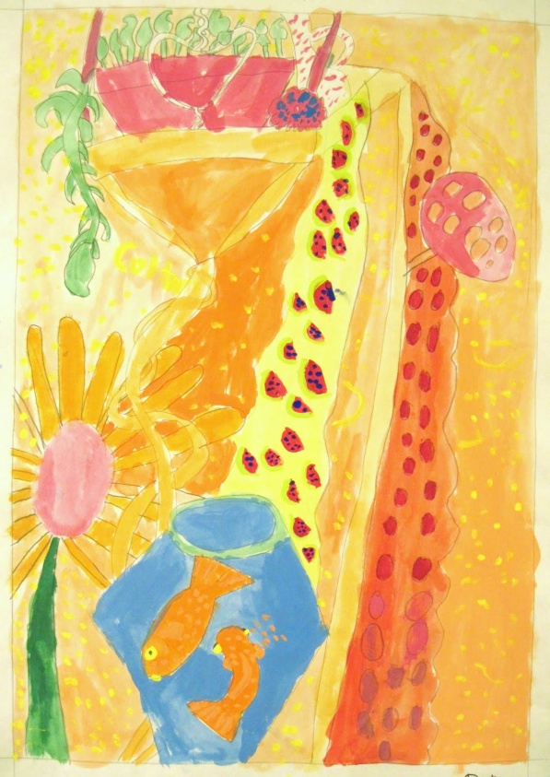
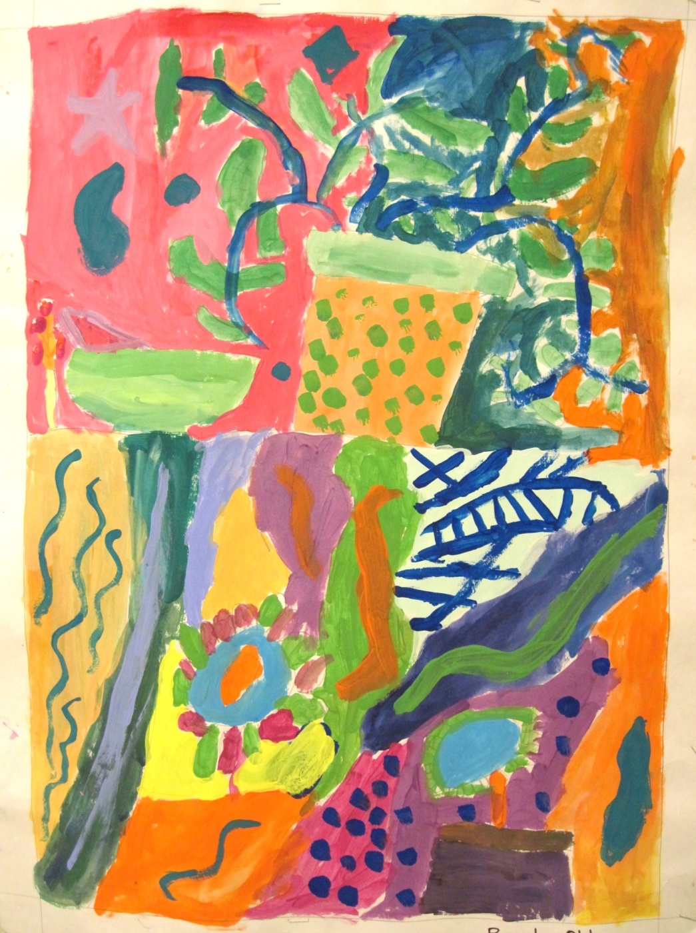
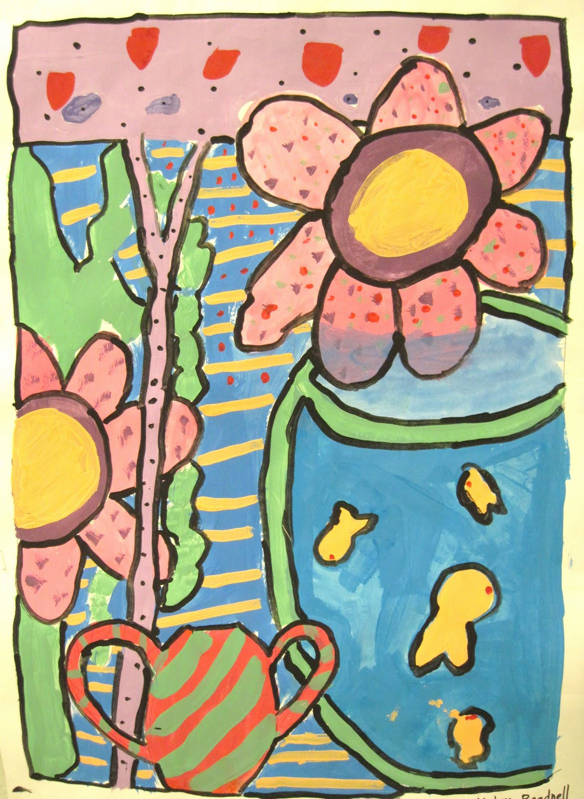
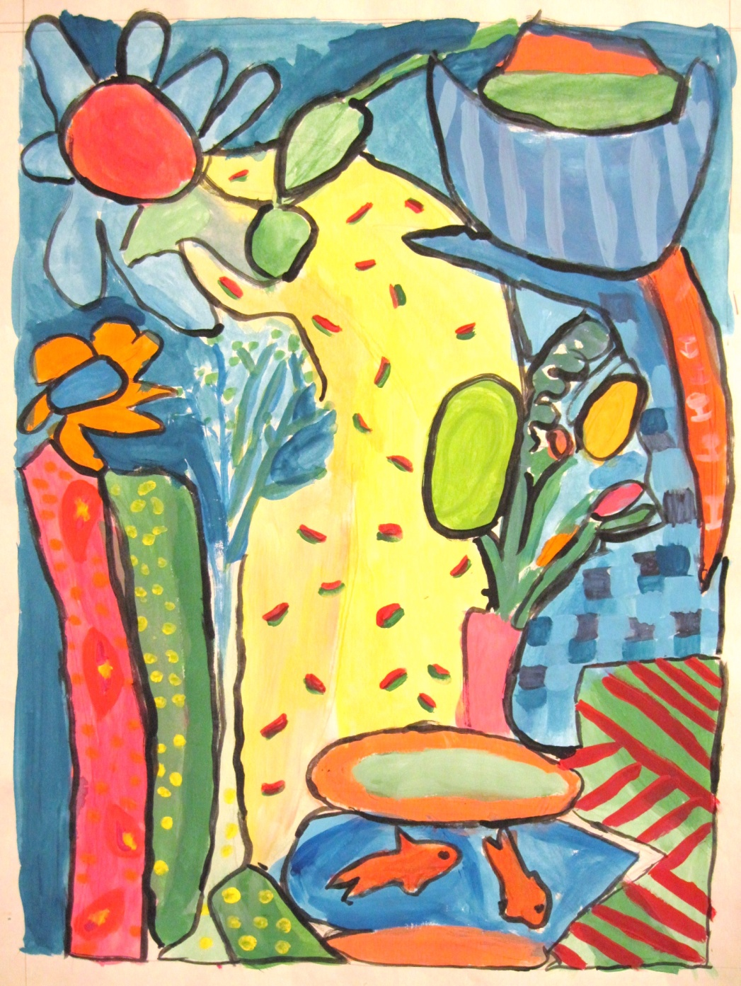
The Sensational
Still Life!
NYSATA 2016
Phyllis Brown
plbrown3@yahoo.com
There’s a Dragon in my Art Room
Plbrown.blogspot.com
Notes:
Intro, handouts, CTLE credits, time framework etc Explain image source

Slide 2
Improve observational skills
Improve drawing skills
WHY??
Making use of the
Elements of Art & Principles of Design

Slide 3
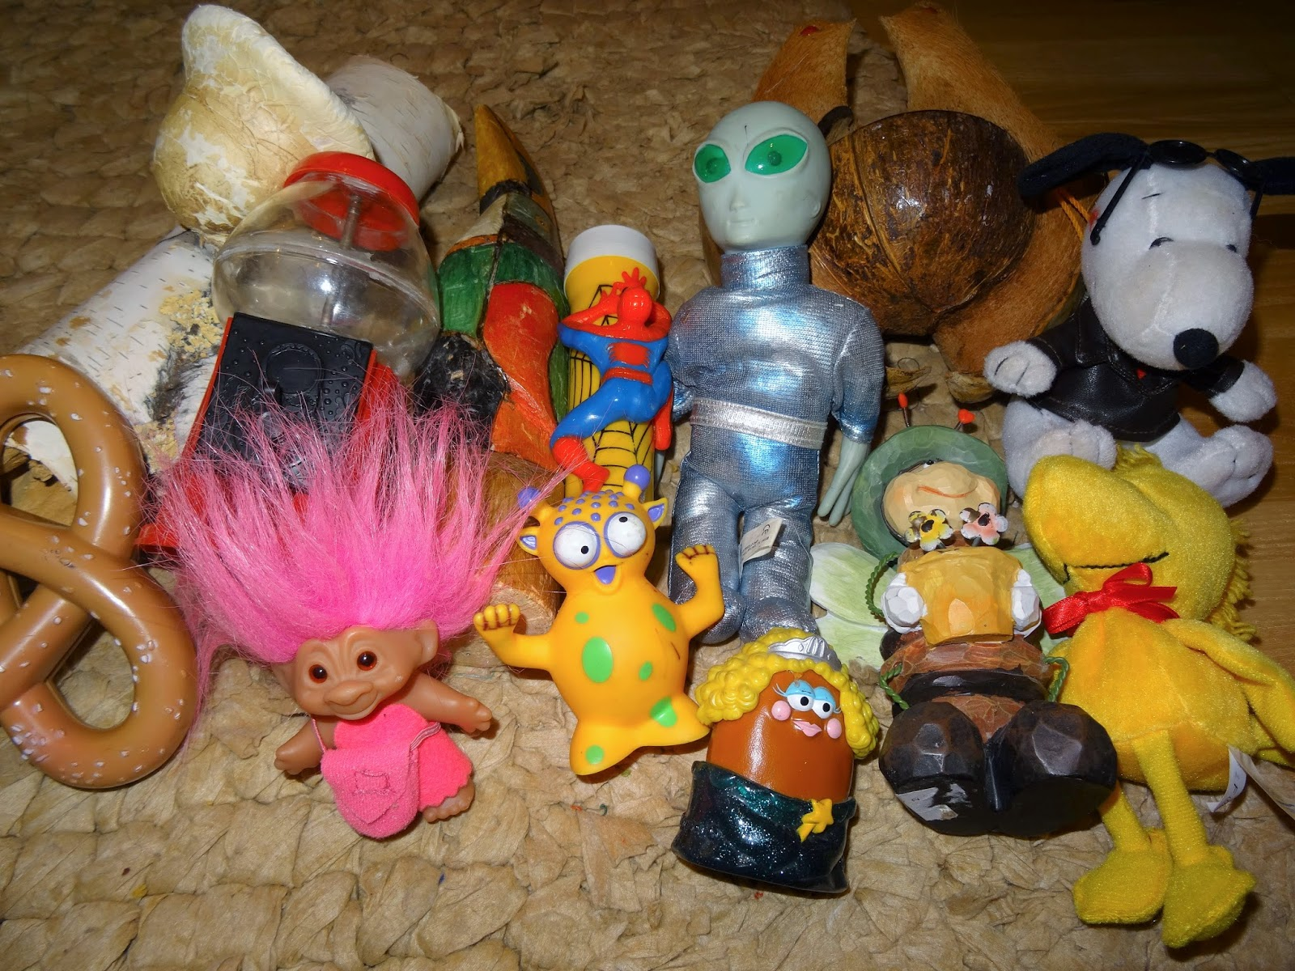
How to create the still life: Finding/selecting objects
Notes:
Yard/garage sales, McDonald’s happy meals, toys. Themes: music, sports, seasonal, all white, at the beach, faux landscape

Slide 4
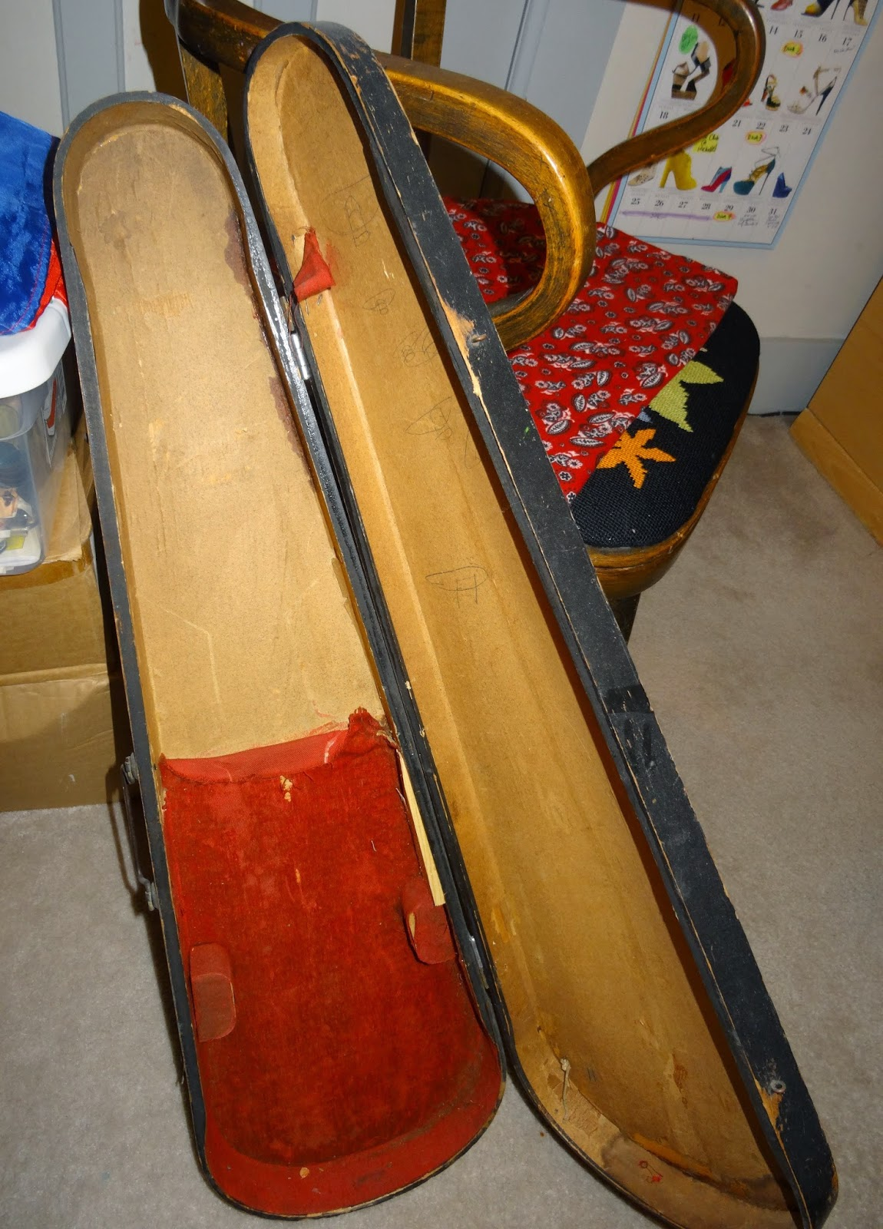
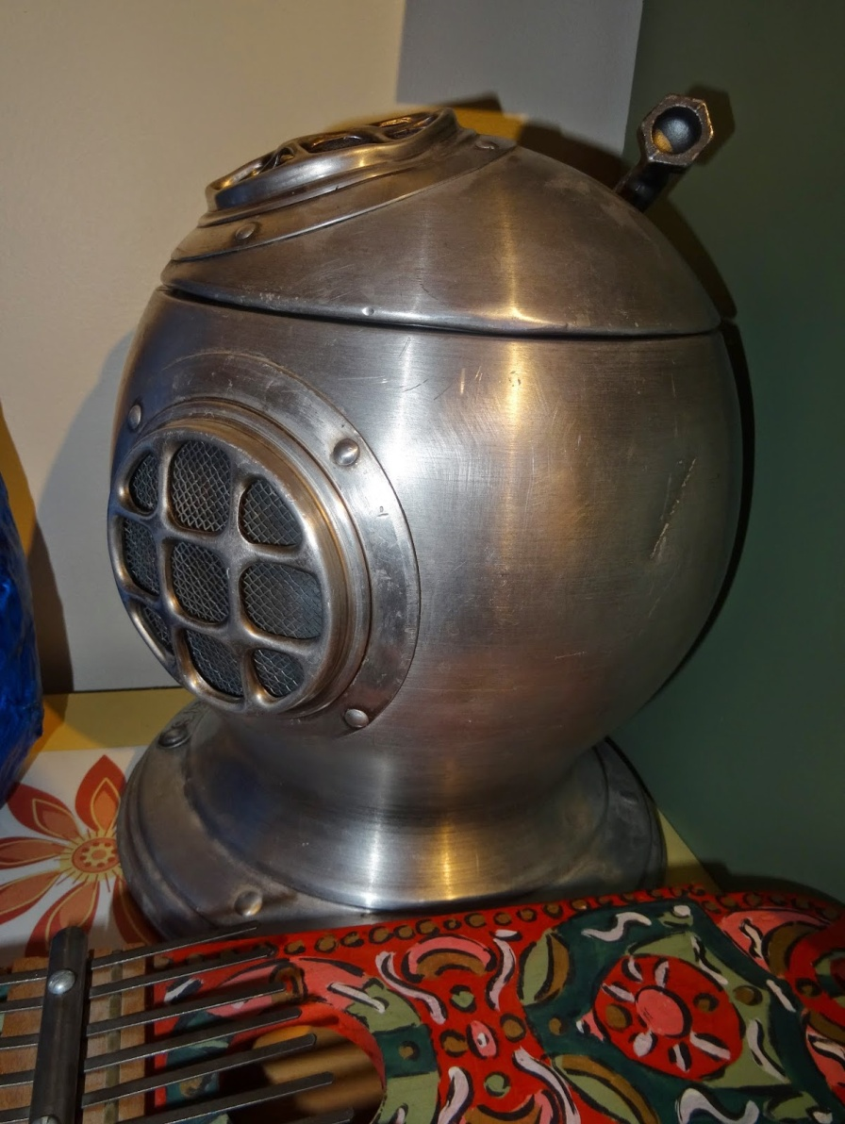
Use a variety of
sizes and shapes
Notes:
Look for large items that can be used to create negative space

Slide 5
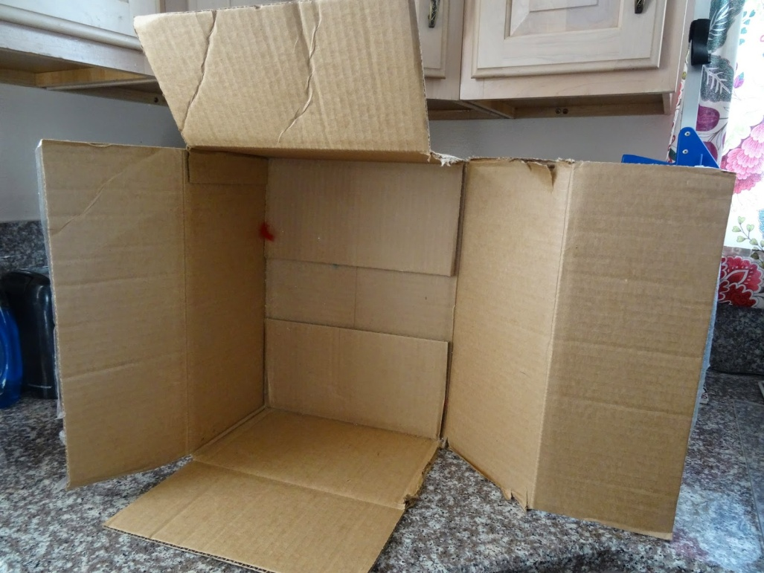
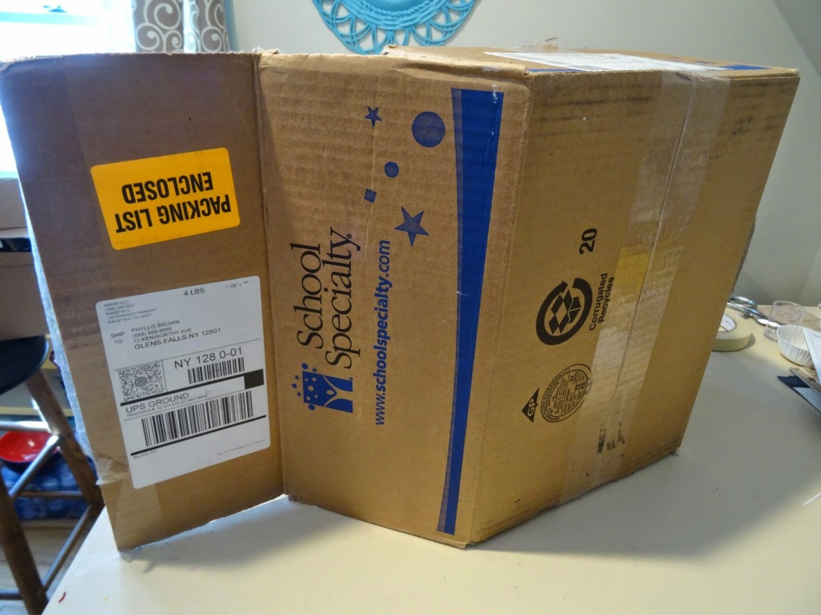
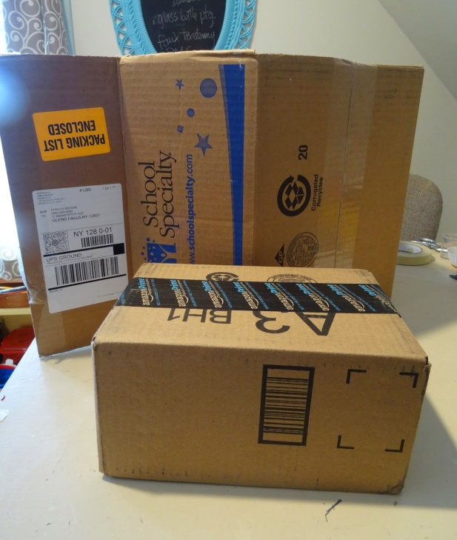
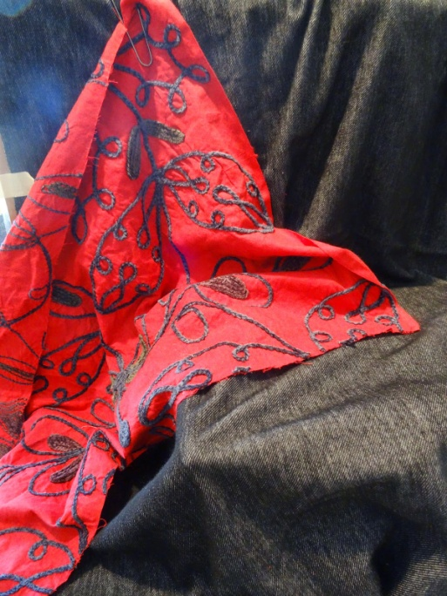
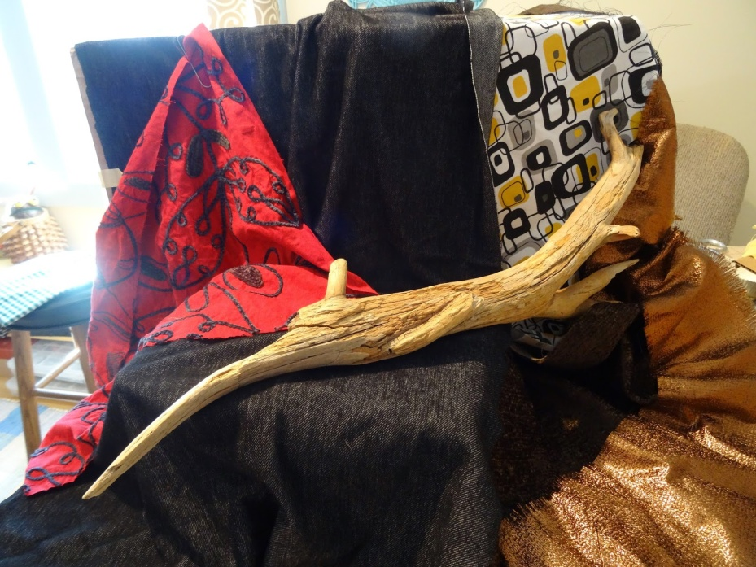
Establish negative space, adding levels & directional lines. Drape!
Notes:
Decide where to put the still life –but will it be on a counter, a windowsill or “in the round”? Drape all sides to establish shapes and directional lines

Slide 6
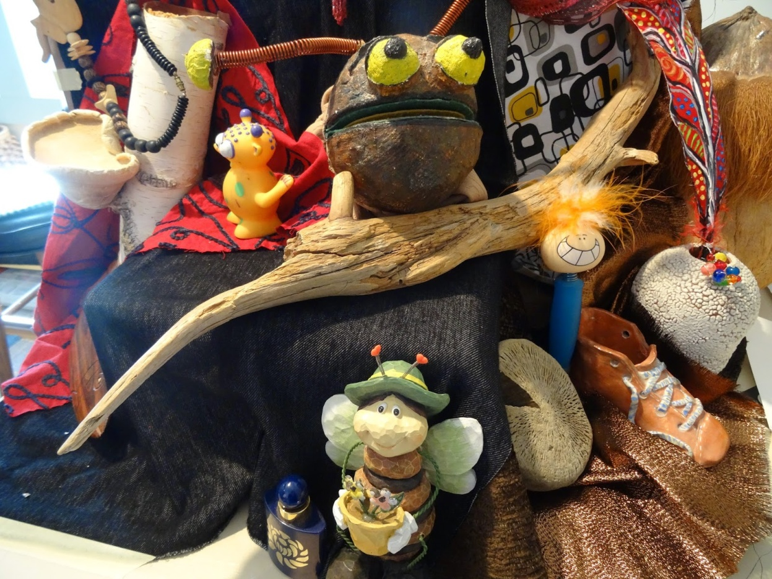
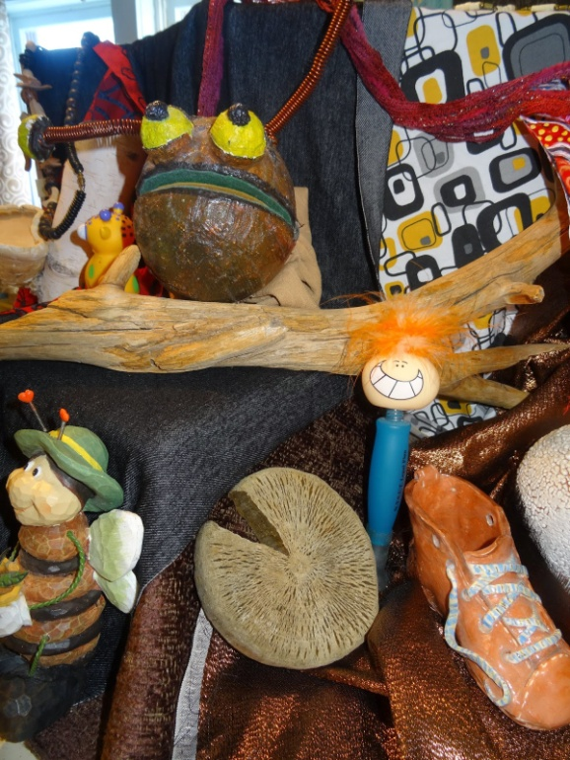
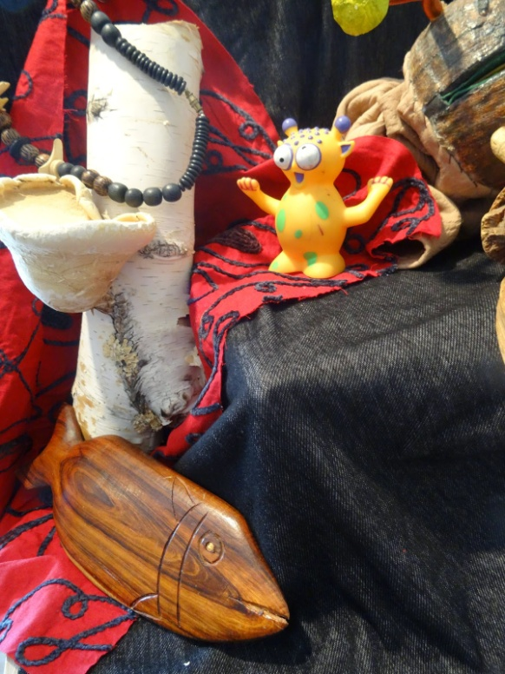
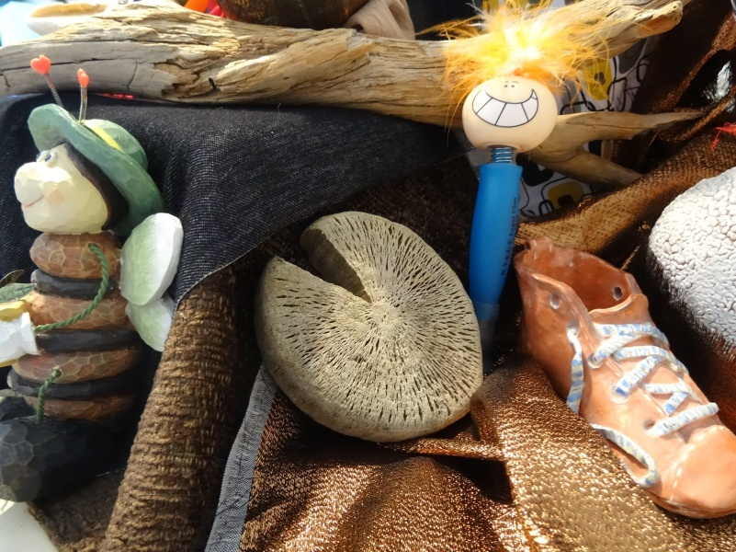
Add objects
and arrange
to create multiple viewing options

Slide 7
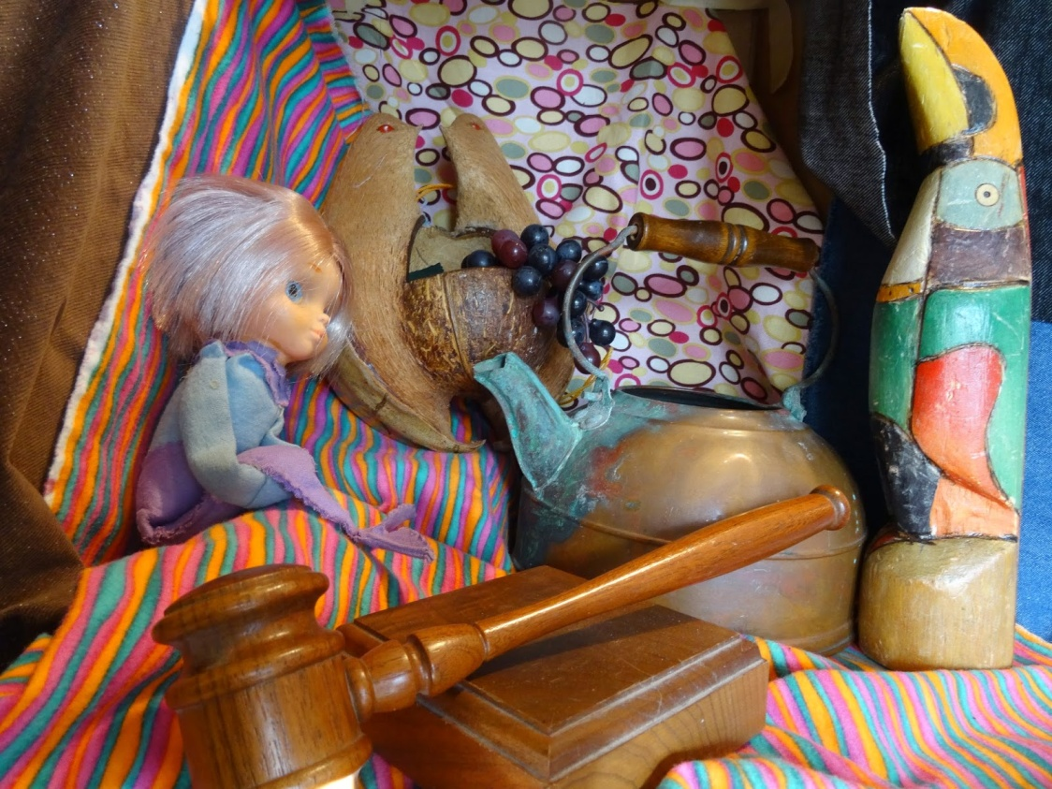
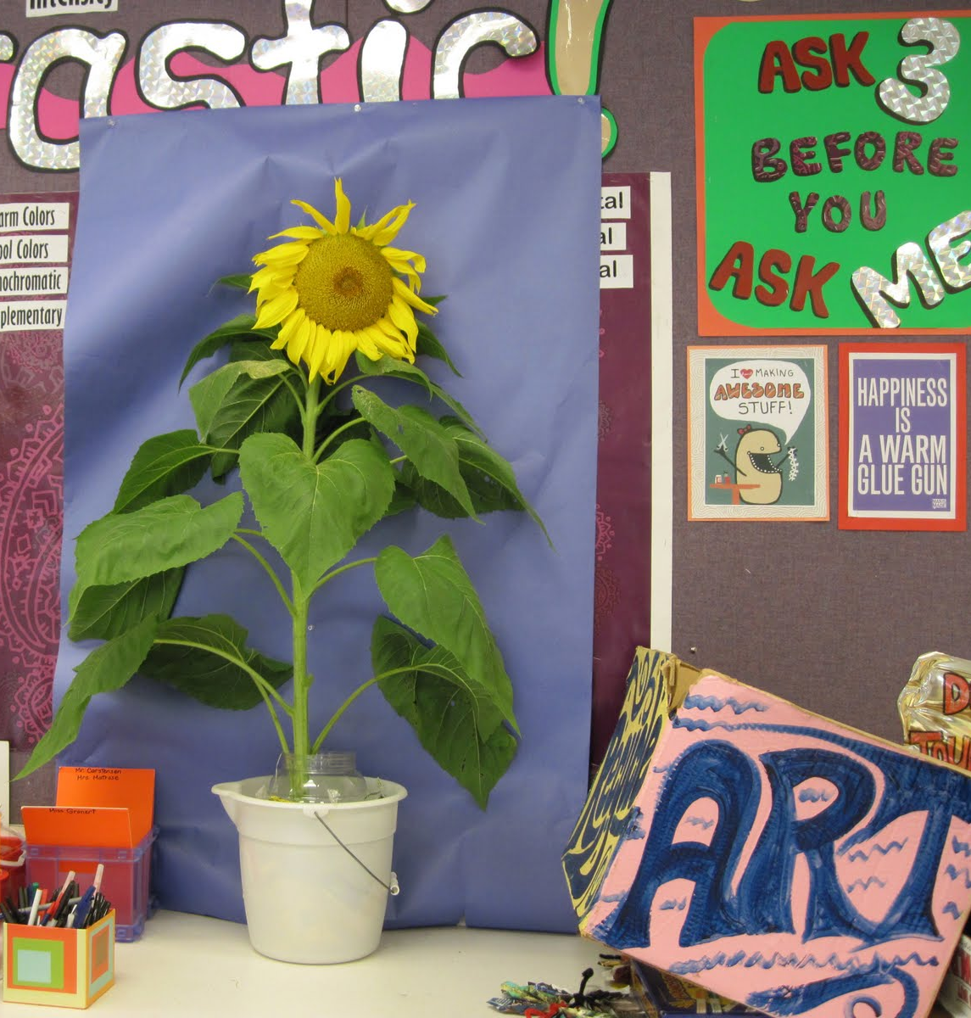
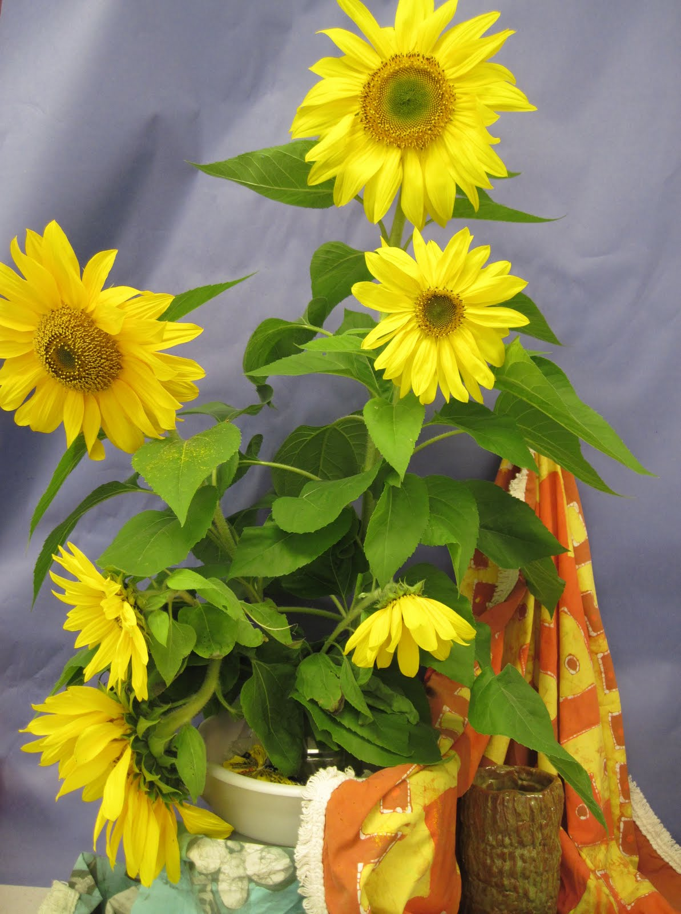
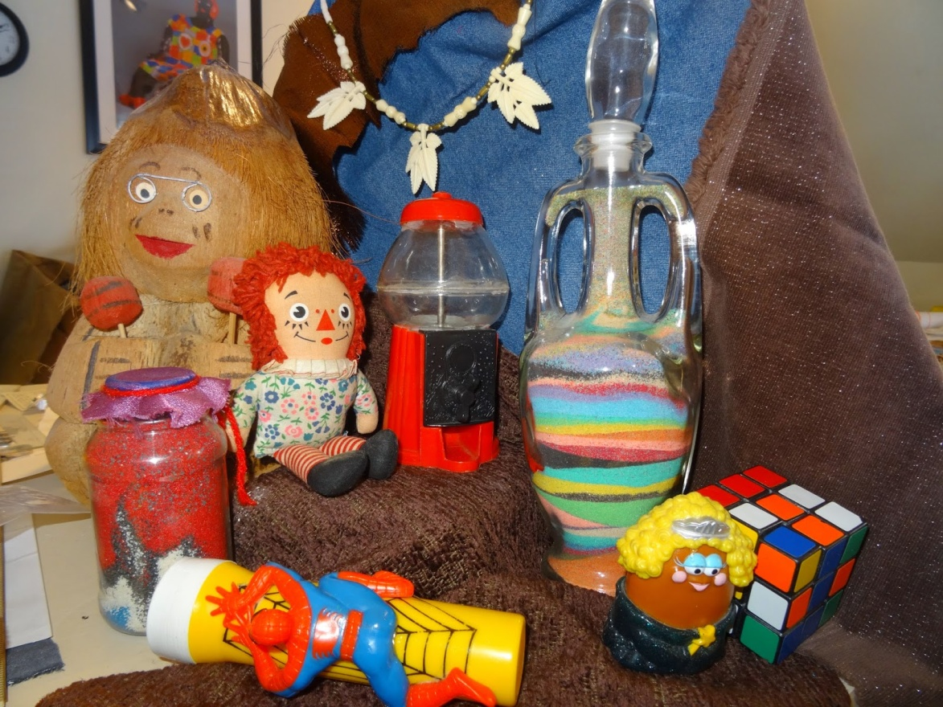
Notes:
Simple or complicated!

Slide 8
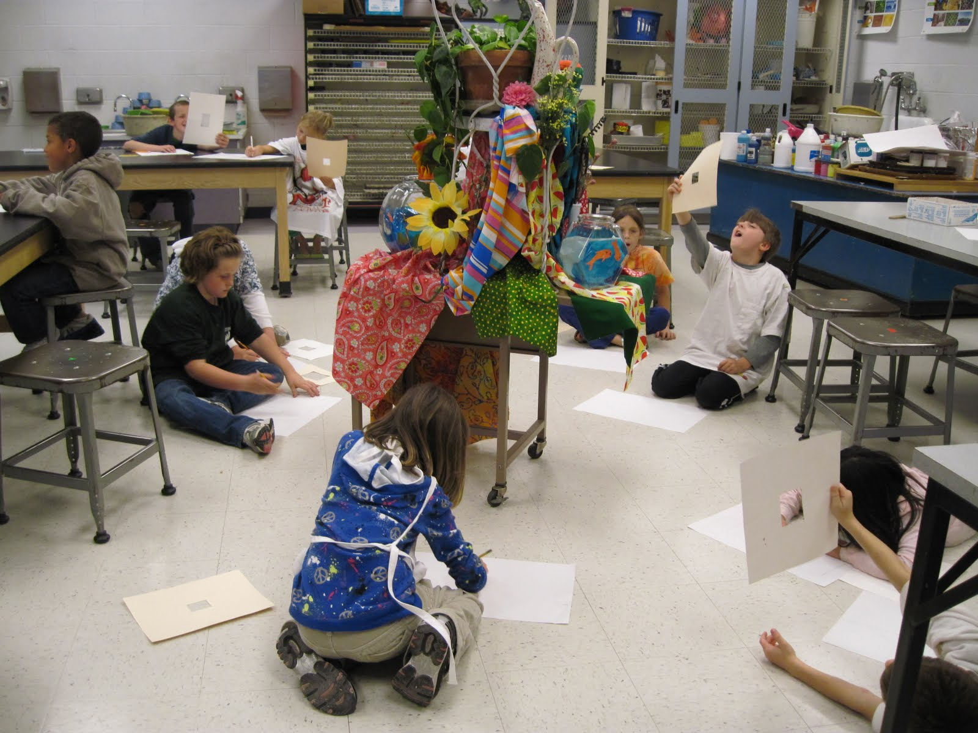
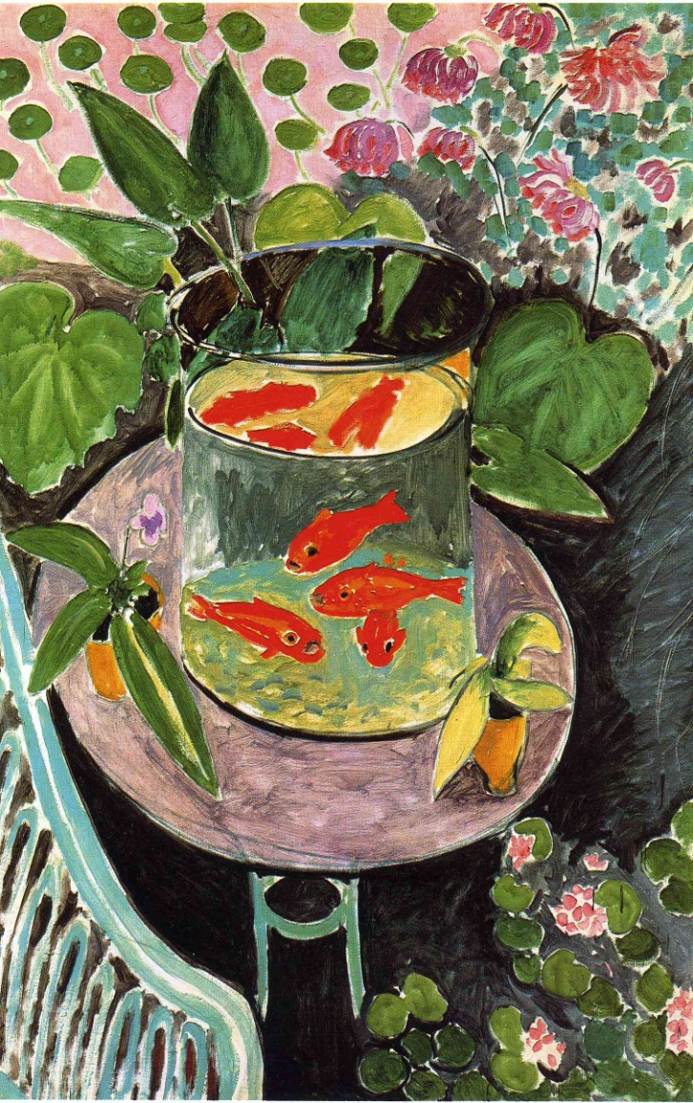
The Goldfish by Matisse
Still life setup “in the round” in homage to Matisse

Slide 9
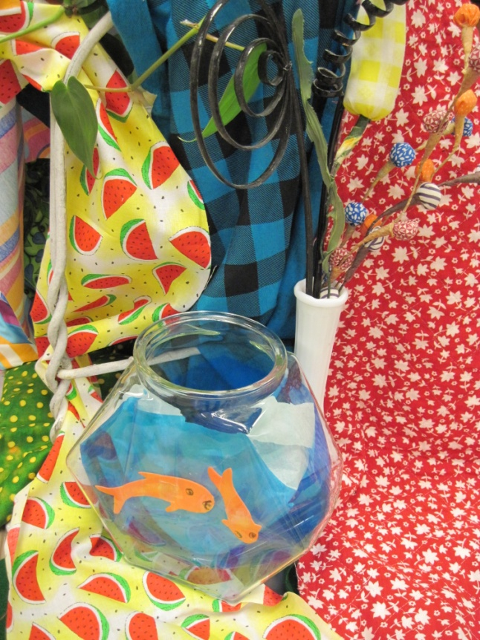
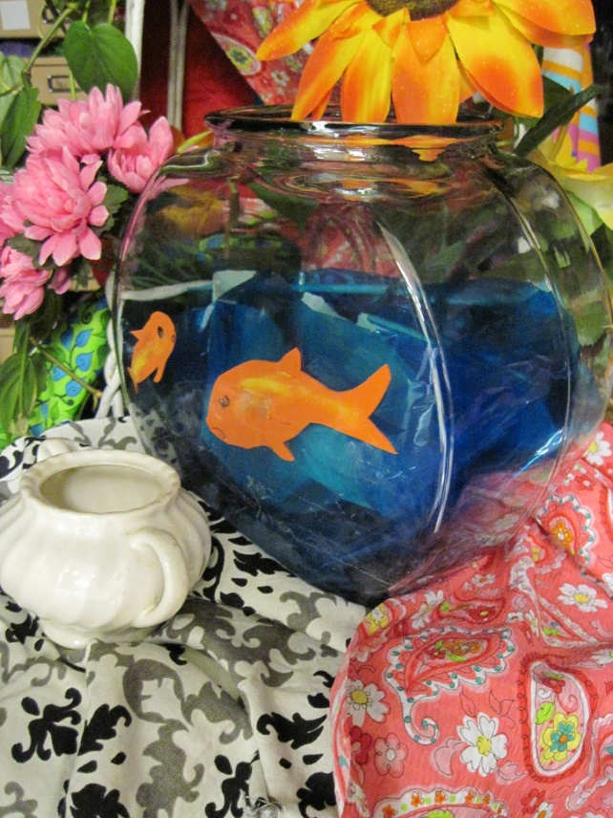
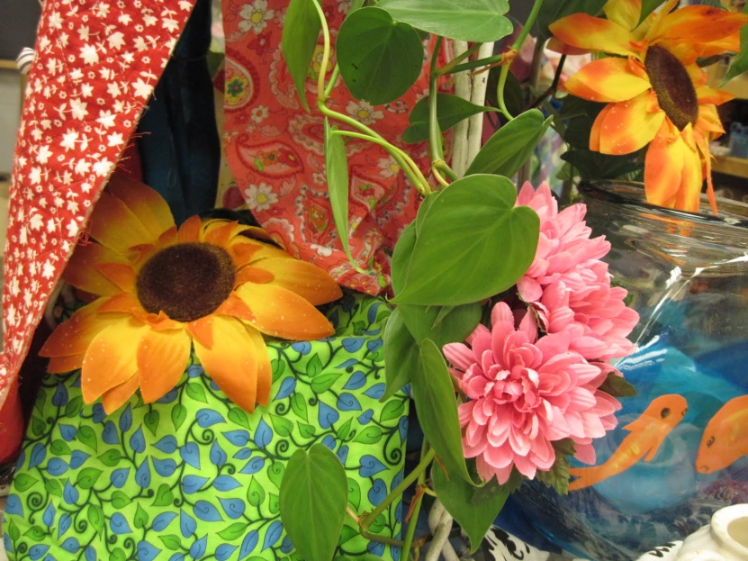
Views from the still life setup in homage to Matisse.
The Goldfish by Matisse

Slide 10
Drawing from the still life, using viewfinders

Slide 11
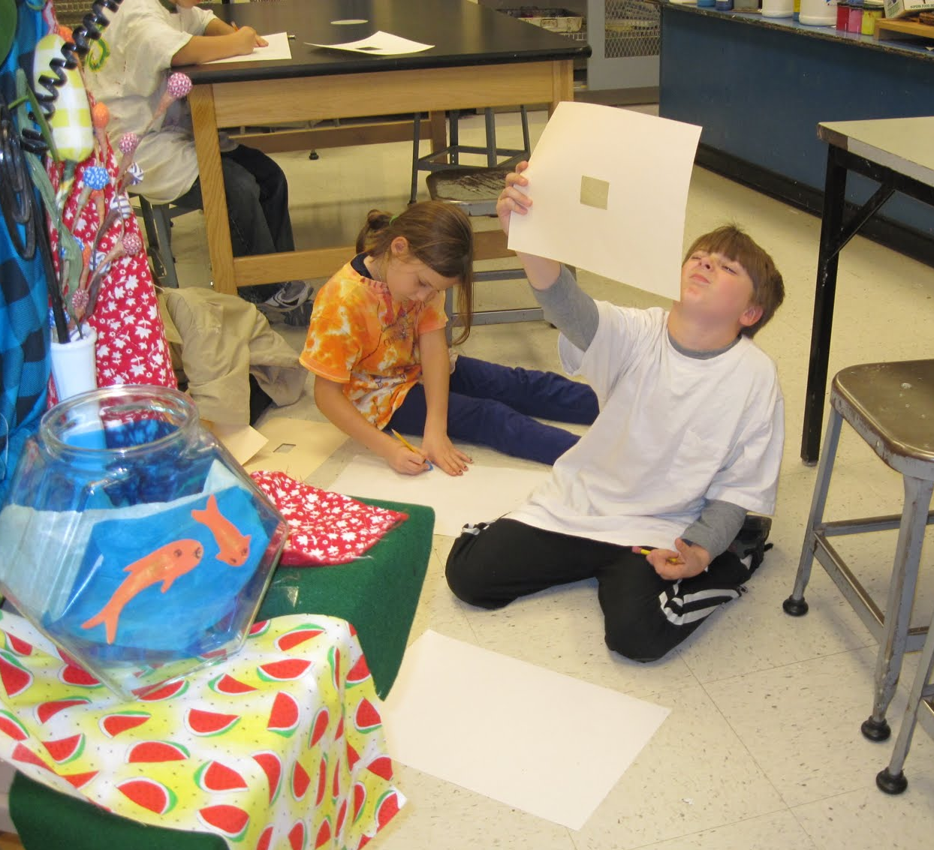
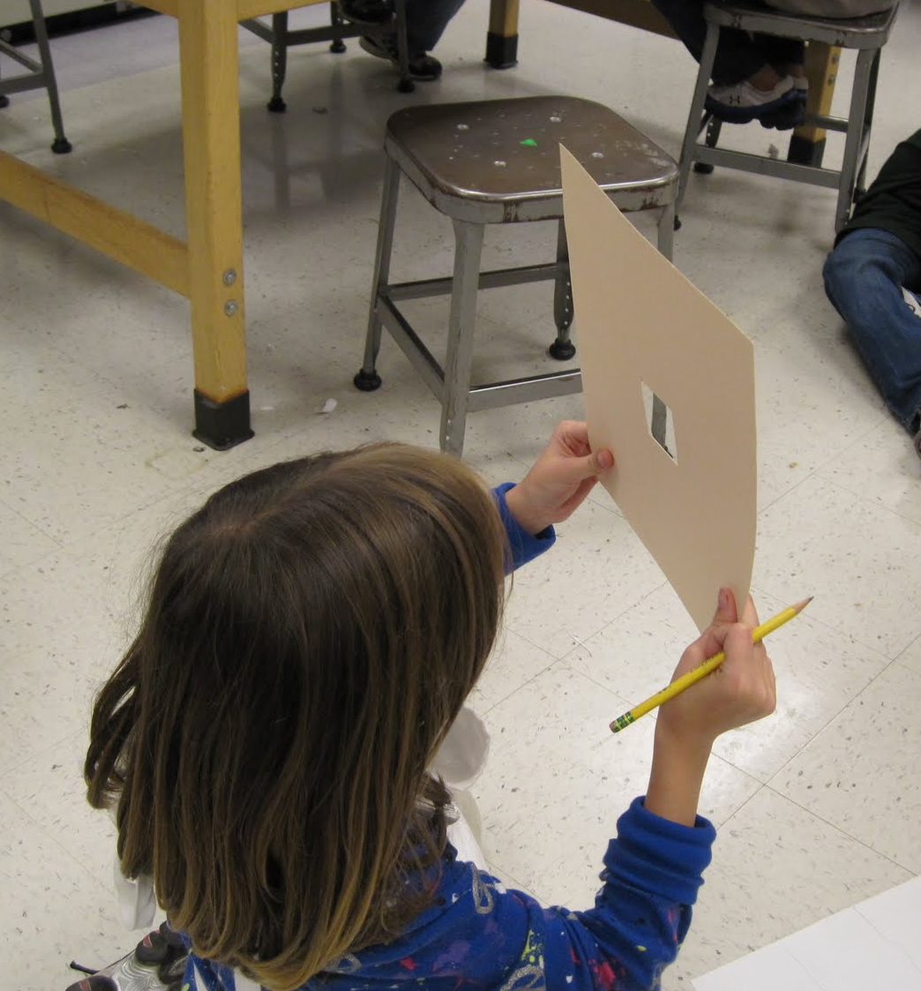
Using a viewfinder
Squint like a Pirate!

Slide 12
4th grade paintings from the still life

Slide 13
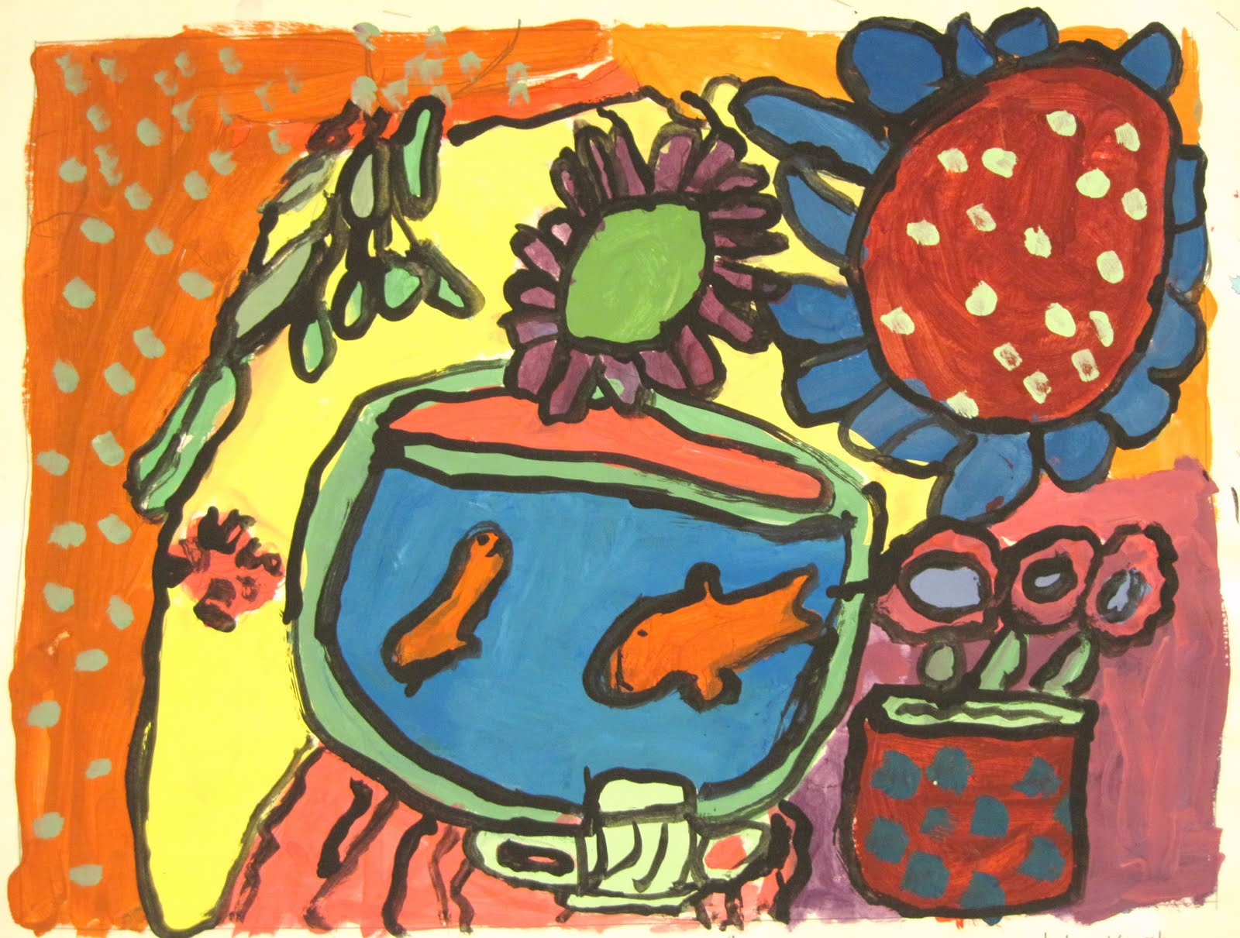

Slide 14
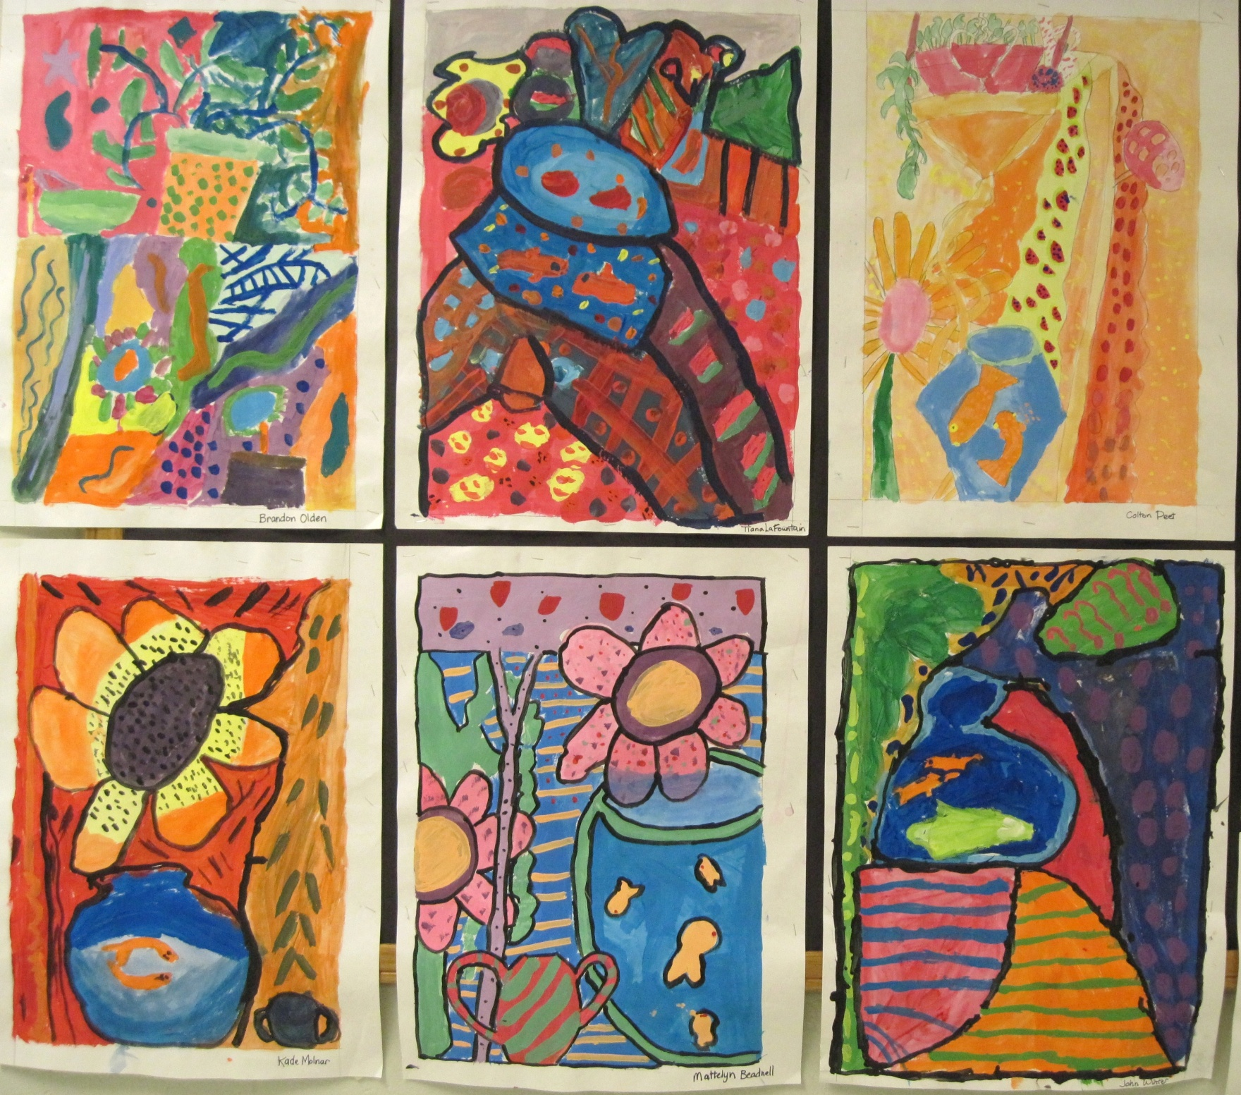

Slide 15
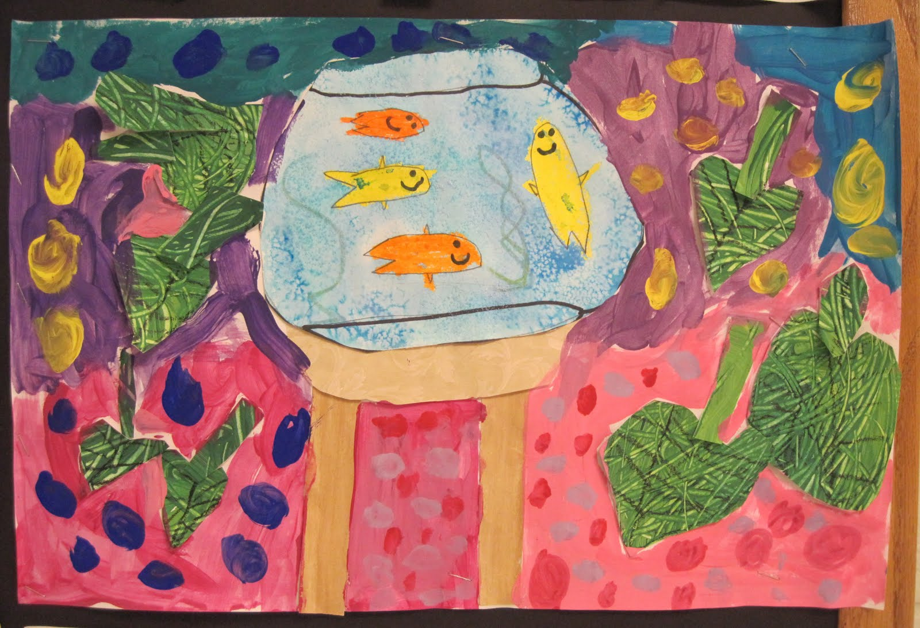
2nd grade “Still Life-ish” paintings

Slide 16
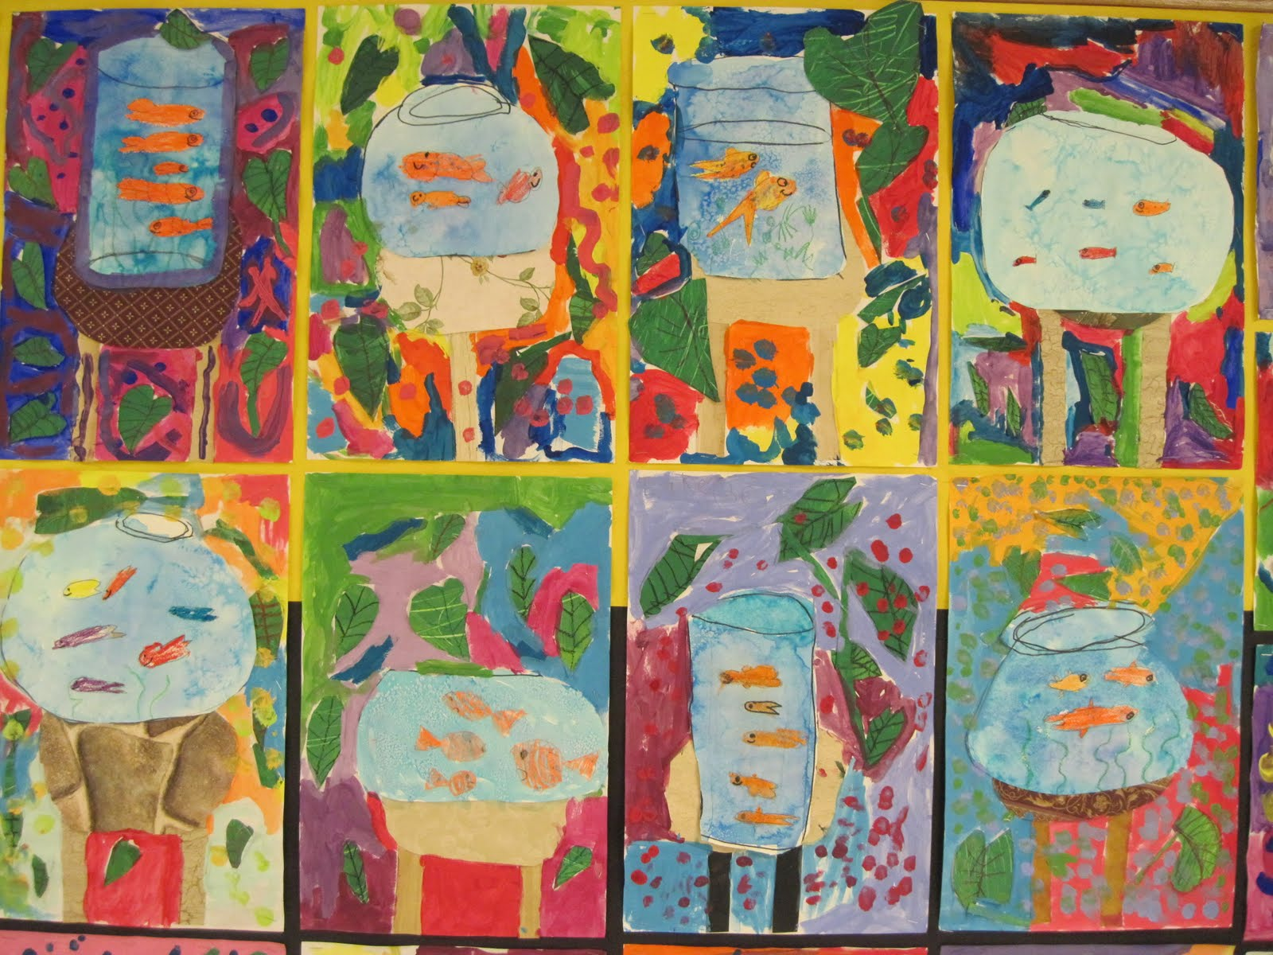
More 2nd grade “Still Life-ish” paintings

Slide 17
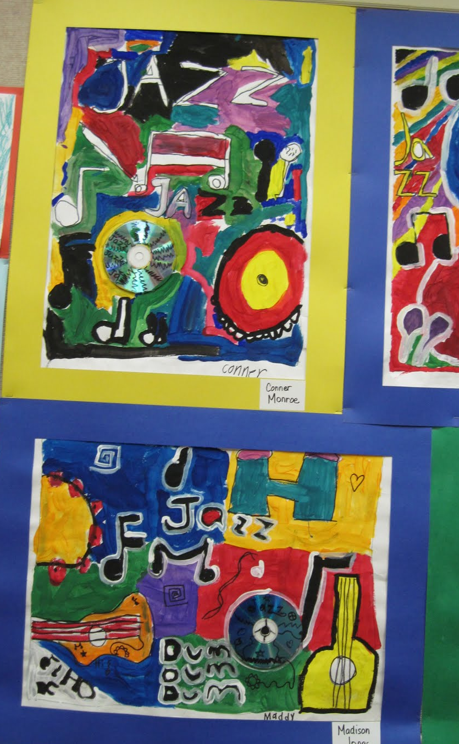
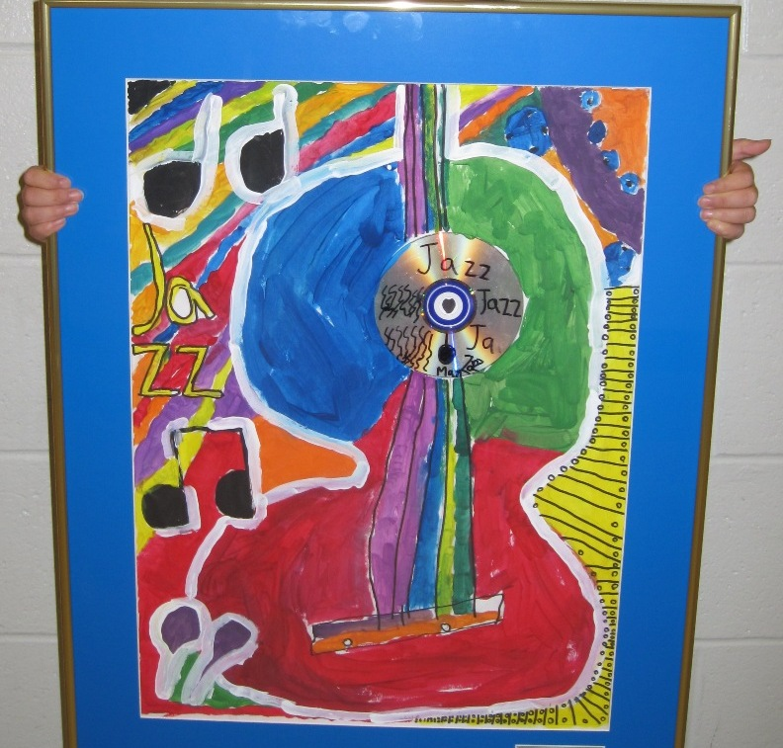
Paintings based on ideas from a musical instrument still life, incorporating CDs

Slide 18
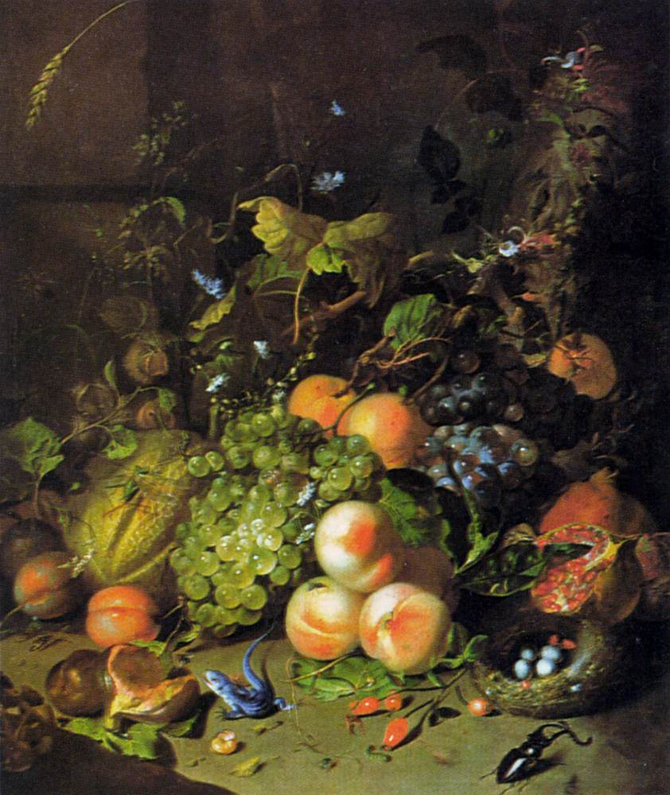
Still Life
with Fruit and Stag Beetle
by
Rachel Ruysch
Try incorporating bugs and other critters, like Rachel Ruysch did!

Slide 19
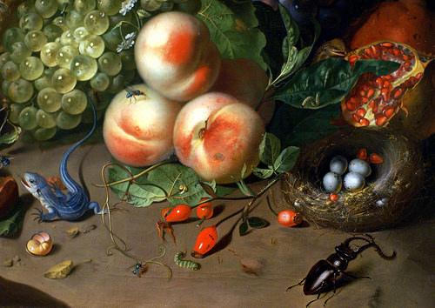
Rachel Ruysch insect/critter closeup

Slide 20
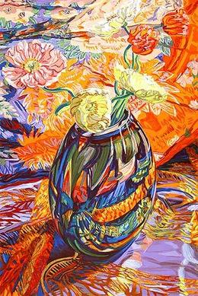
Glassware Paintings
by
Janet Fish
Or look for abstract design in transparent and reflective items, such as glassware (like Janet Fish), or marbles, or metal.

Slide 21
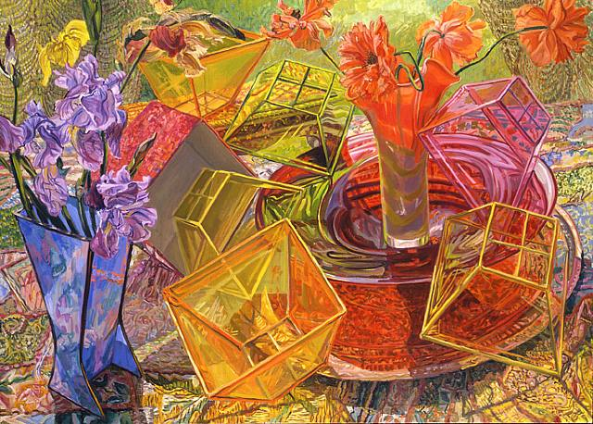

Slide 22
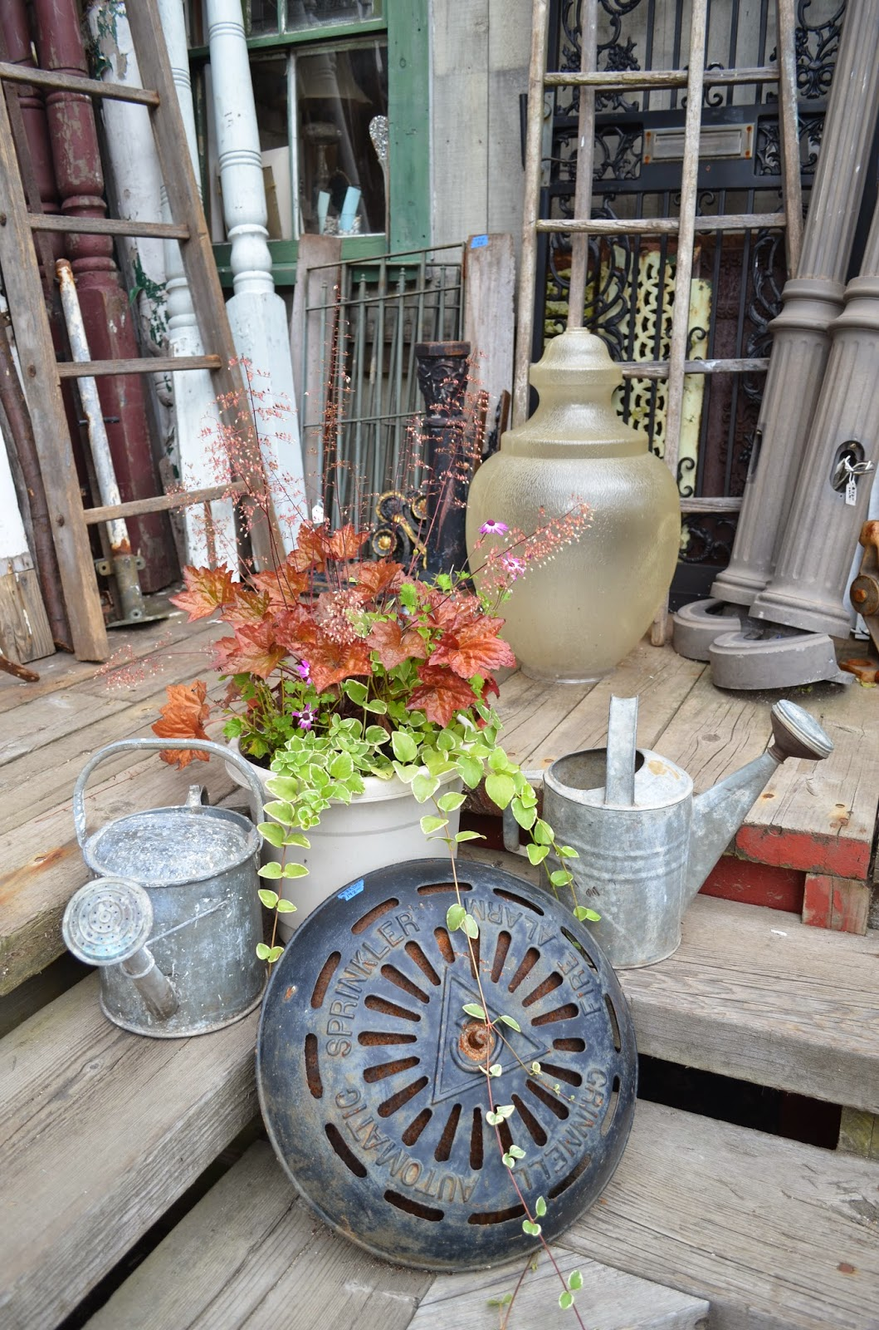
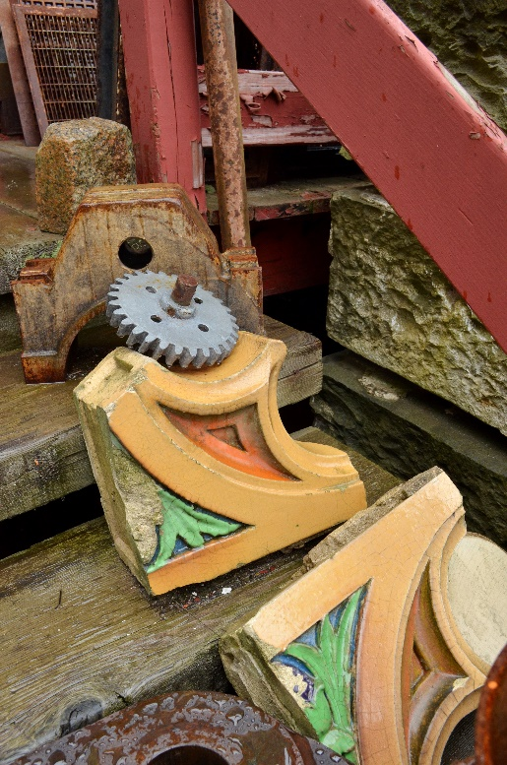
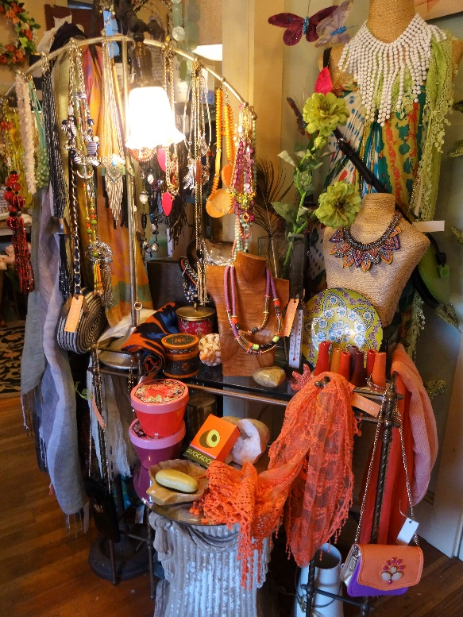
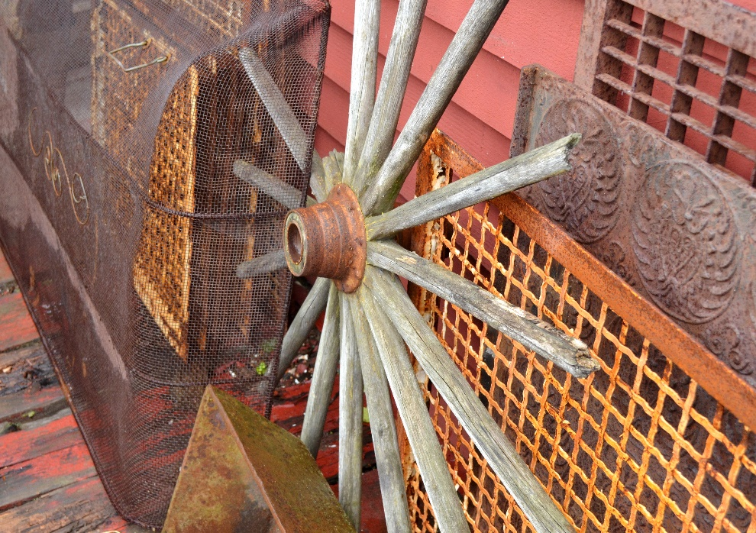
Find still life arrangements everywhere!

